Slide 1
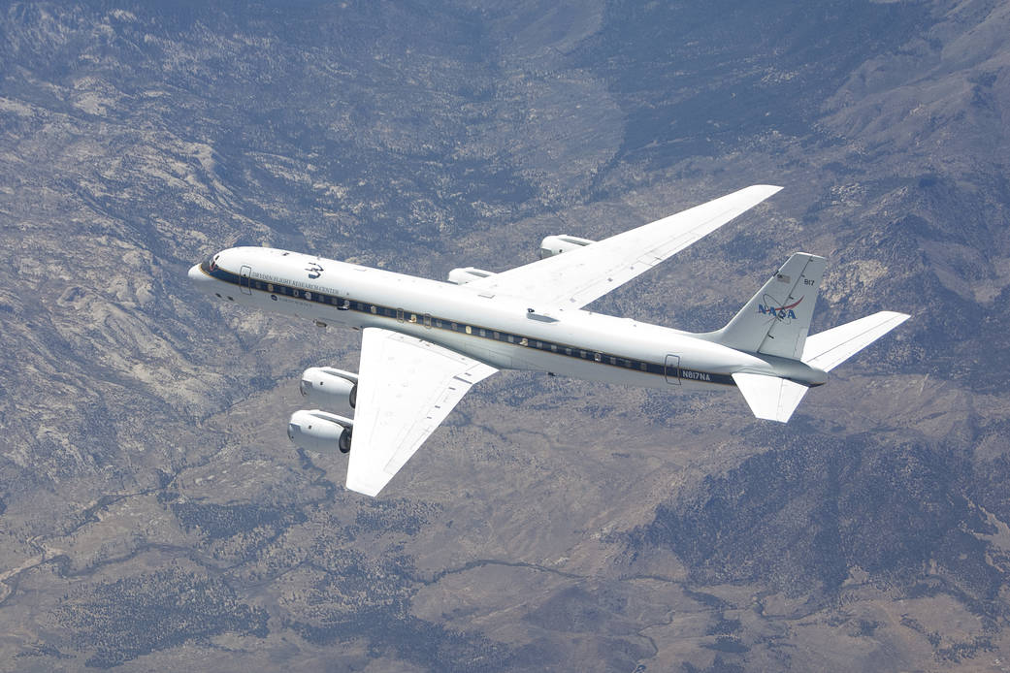
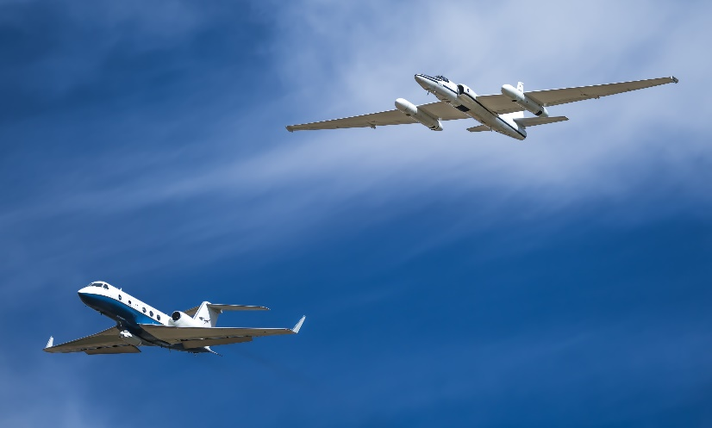
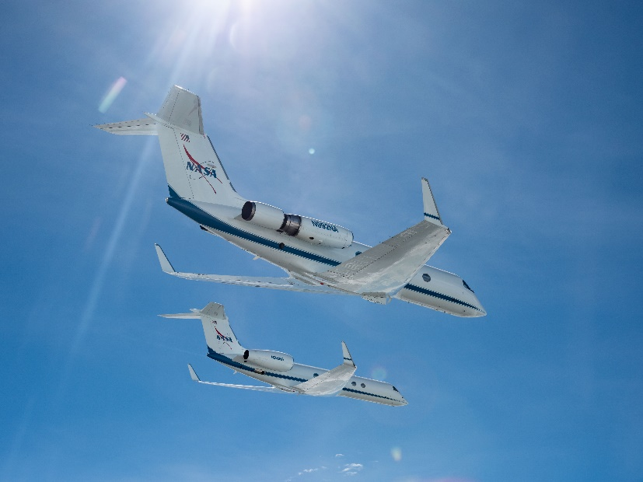
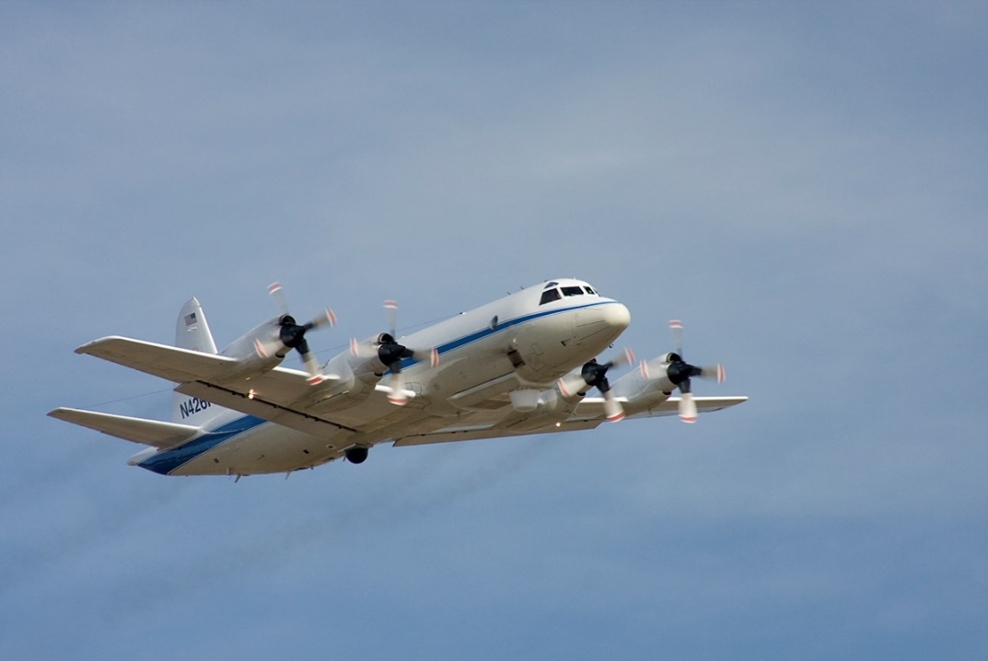
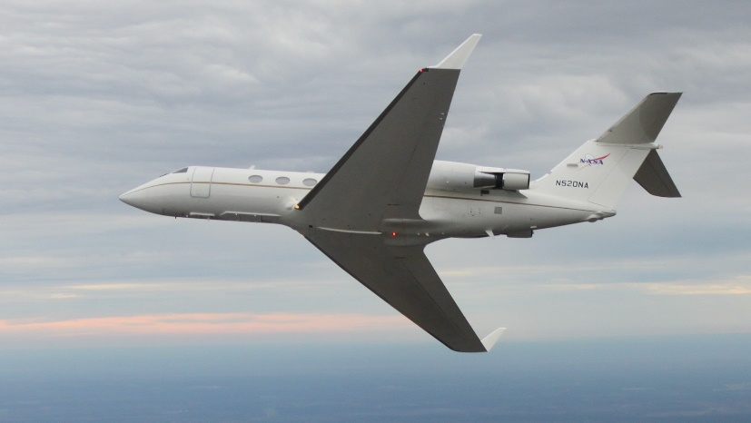
NASA ASP Supported Aircraft
Presentation to UAS Workshop
Bruce Tagg
Mar 2021

Slide 2
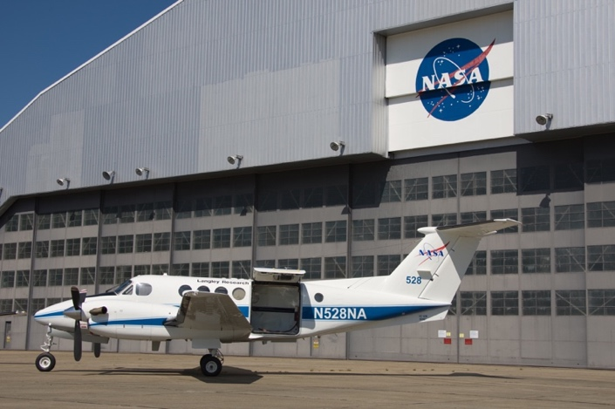
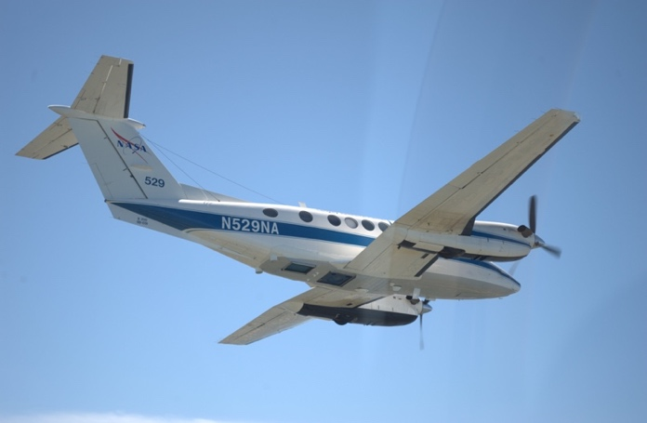
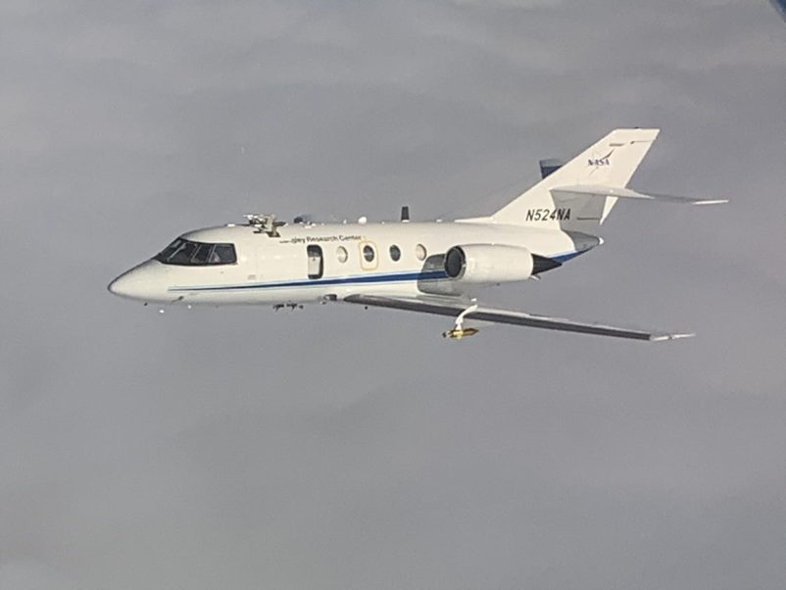
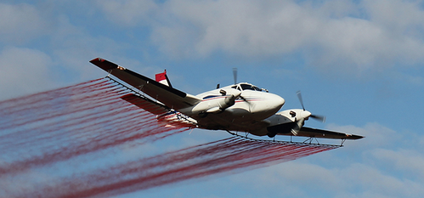
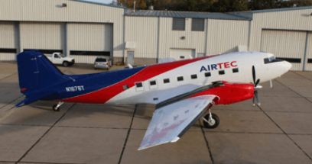
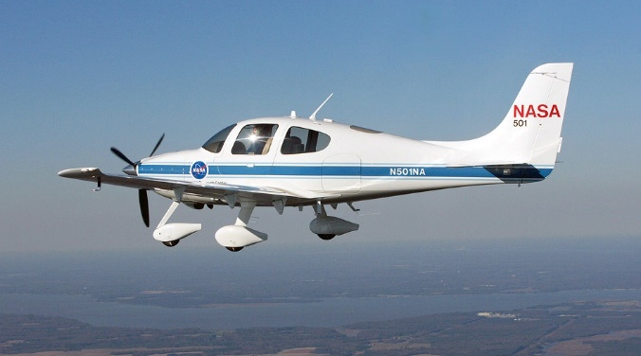
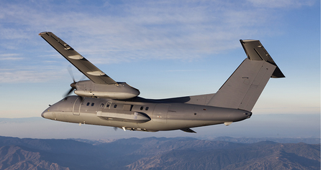
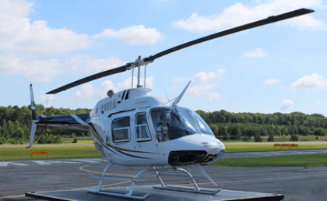
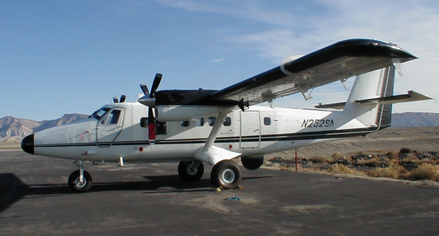
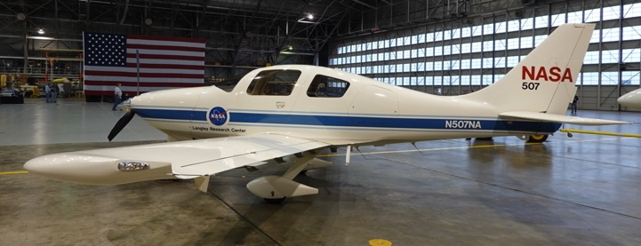
Other Aircraft (not all!)

Slide 3
ESD Airborne Science
ASP works for and is funded by ESD, i.e the Program Scientists
ESD requirements = 8 supported aircraft
Currently there are NO funded requirement from ESD for UAS
We have developed and supported multiple UAS over the years (see Matt’s presentation)
I love all aircraft! Small, mid, large, ugly/sleek – it does not matter
UAS are just aircraft…….

Slide 4
Questions for Science
Why UAS vs the plethora of other aircraft?
Where do you want to fly?
How high, how long, in what conditions?
How big are the instruments you want to fly?
How much power do you need?
What environments do your instruments require to survive (temp, vibration, clean air, etc.) and take data?
What’s the real airborne requirment?

