Slide 1
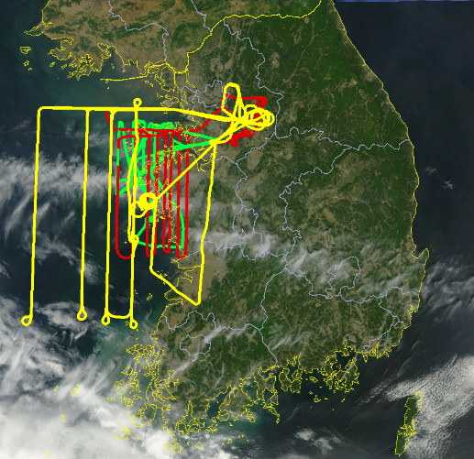
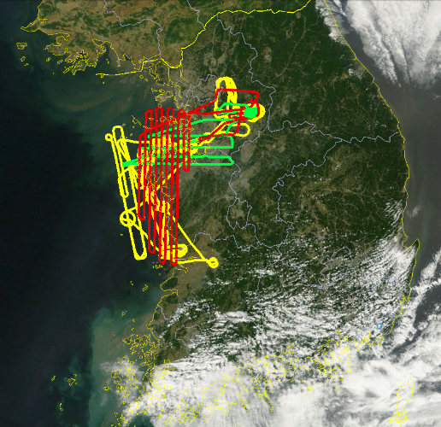
Question 1: How significant is the impact of the large point sources (power plants and petrochemical plants) along the west coast to the air quality of SMA temporally and spatially?
NASA DC-8
Hanseo King Air
NASA King Air
Coordinated airborne sampling of point sources on 22 May and 5 June during KORUS-AQ
Notes:
Coordinated sampling of point sources was the major goal for two flight days during KORUS-AQ. Sampling of the Daesan Chemical Facility was also conducted on three other flight days: 30 May, 2 June, and 3 June.

Slide 2
Preliminary Finding: Emissions of SO₂ and VOCs from point sources are underestimated by factors of 3 to 5.
Table Comparing DC-8 Observations with Power Plant SO2 estimates
Joon-Young Ahn
Figure illustrating Daesan observations compared to VOC emissions estimate
Seokhan Jeong
The relative contributions from operations and storage are not known.
Notes:
Table contributed by Joon Young Ahn (NIER) and figure contributed by Seokhan Jeong (GIST)
Additional work contributing to this finding will require finalizing data for a more complete speciation of VOC emissions. SO2 data are also being corrected for nonlinear responses at high SO2 concentrations which are expected to increase final reported values. Analysis will also be needed to fully analyze each of the five visits to the Daesan petrochemical facility by the DC-8.

Slide 3
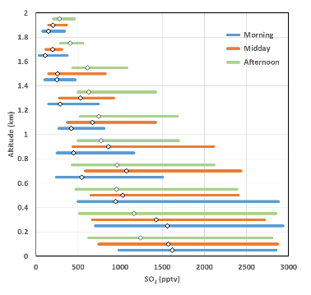
Preliminary Finding: In addition to power plants, there appears to be a general underestimation of SO2 emissions.
Power Plant
37° 3‘30"N
126°30'36"E
Steel Plant?
36°59'14“N
126°41'54"E
DC-8 Profiles over Seoul
Medians (50%) and Inner Quartiles (25-75%)
There are other potential sources that were not directly sampled during KORUS-AQ.
Notes:
Figures contributed by Greg Huey (Georgia Tech)
Left figure shows emissions in a power plant plume which is contrasted with the central figure showing another point source producing 7 times more SO2 per CO2 emitted.
The right figure shows statistics for the SO2 distribution over Seoul measured from the DC-8

Slide 4
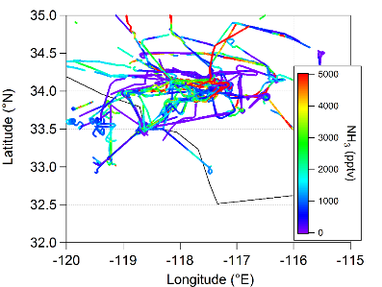
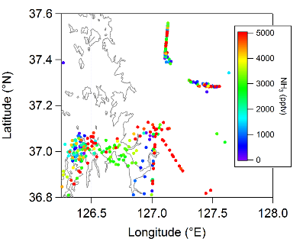
Preliminary Finding: Pervasive ammonia emissions may be rapidly accelerating aerosol formation near point sources
Observations of NH₃ over
Los Angeles during CalNex, 2010 (Dr. John Nowak)
Calculated NH₃ over Seoul from aerosol observations aboard the NASA DC-8
Location | Median (pptv) | Upper quantile (pptv)
Los Angeles | 1000 | 3000
Seoul | 3000 | 5000
Ammonia is typically dominated by fertilizer use, animal husbandry, and gasoline catalytic converters. Typically, ammonia emissions from stacks is not significant.
Notes:
Figures contributed by Ben Nault and Pedro-Campuzano Jost (CU-Boulder)
Estimates show that 2-3 times more ammonia is available in Seoul versus Los Angeles to contribute to PM formation.

Slide 5
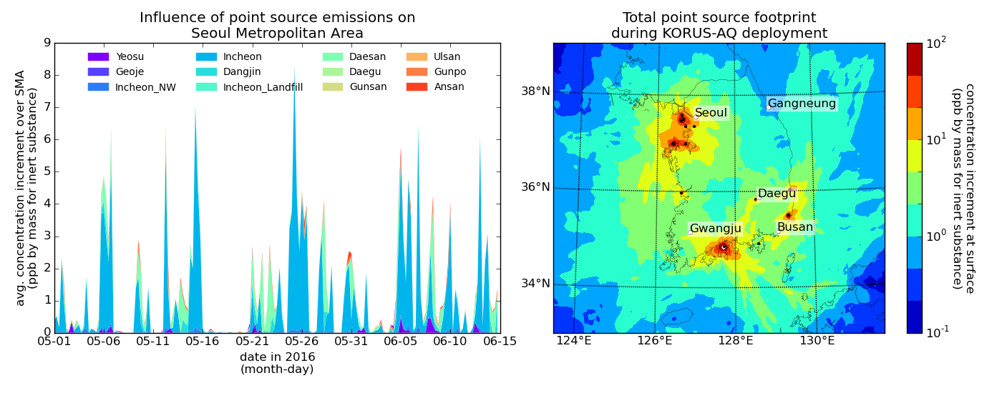
Preliminary Finding: During the KORUS-AQ period, point source emissions from the west coast had their greatest impact to the east and had episodic impact on SMA
Analysis of KORUS-AQ observations will be needed to fully corroborate point source impacts on SMA
Notes:
Figures contributed by Christoph Knote (LMU Munich) – Calculations are for VOC emission from point sources showing large differences in day-to-day impacts on SMA (left) and slightly greater impacts overall to the east. Additional details on the assumptions used for the calculations are provided below.
Simulations of particle dispersion from major point sources in South Korea were conducted using the FLEXPART model in version 9.2 (Stohl et al., ACP, 2005). The Weather Research and Forecasting (WRF) model in version 3.6.1 at 5 km horizontal resolution provided the driving meteorology for these simulations. WRF itself was nested in 6 hourly NCEP GFS analyses, with 3 hourly forecasts interlaced. Grid nudging was applied to the WRF simulations to ensure the mesoscale dynamics resemble the GFS input.
Every 6 hours for the whole duration of the KORUS-AQ campaign, a FLEXPART simulation was conducted. A total of 2x10^6 particles are released during the simulation from the 14 largest point sources for volatile organic compounds, considering the emission strength of each source (pers. comm. Jung Hun Woo, Konkuk University, Seoul). Particle locations are tracked for 72 hours, and their distribution in the atmosphere at the end of the simulation is recorded.
Uncertain atmospheric processed like convection and turbulence are applied to each of the particles in a stochastic manner by FLEXPART. The result of each simulation is hence a 3D field of the dispersion of emissions from each point source after three days of continuous emission. This field has units of ‘ppbm’ (parts per billion per mass), as it reports the increase in concentration of a tracer that would be observed at a certain location due to the emissions from a given (point) source. This tracer is considered to be inert, as no source or loss processes other than emission from the point source are considered. From the FLEXPART simulations we use the particle concentration field in the lowest 100 m above ground, as this is where the point source plume is affecting the Korean population.
In the plots, the right panel shows a map of the concentration increase of an inert tracer due to point source emissions as an average over the whole KORUS-AQ deployment. Clearly visible are the hotspots of point source activity west and southwest of Seoul, as well as in Busan and in the Yeosu area down south.
The left panel shows the average concentration increments in the Seoul Metropolitan Area (SMA) due to emission from the individual point sources as time series. It becomes clear that especially the Incheon source is the dominant contributor to increments in the SMA, followed by the Daesan source.

Slide 6
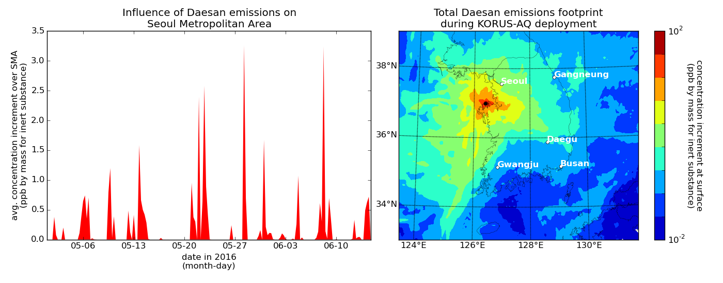
Preliminary Finding: During the KORUS-AQ period, point source emissions from the west coast had their greatest impact to the east and had episodic impact on SMA
Analysis of KORUS-AQ observations will be needed to fully corroborate point source impacts on SMA
Notes:
Figures contributed by Christoph Knote (LMU Munich) – Calculations are for VOC emissions from the Daesan Peterochemical Facility, which shows large differences in day-to-day impacts on SMA (left) and slightly greater impacts overall to the east of Daesan on southern portions of SMA.
For additional details on the assumptions used for the calculations, see notes for the previous slide.

Slide 7
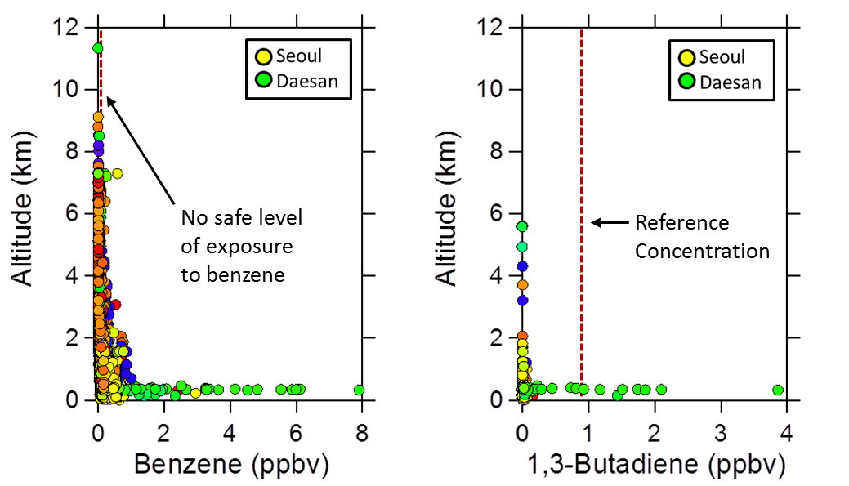
Preliminary Recommendation: Further monitoring of facilities handling toxic compounds is needed to determine the potential health impacts to workers and local populations.
Monitoring could be accomplished by airborne and/or fenceline observations
Notes:
Figures contributed by Isobel Simpson (UC-Irvine) use benzene and 1,3-butadiene as examples of toxic chemicals present at concentrations worthy of further scrutiny due to health concerns. Detailed comments are provided below. Comments are applied specifically to Daesan which was sampled extensively by the DC-8, but attention to other facilities is needed as well.
During KORUS-AQ many VOCs were strongly elevated downwind of the Daesan petrochemical facility.
(2) At least 25 VOCs showed their highest mixing ratios of the mission downwind of the Daesan facility, including two known carcinogens (benzene, 1,3-butadiene).
(3) The benzene and 1,3-butadiene levels were well below short-term (8 hr) exposure limits of 0.1 ppmv and 1 ppmv, respectively (ATSDR, 2007; 2012).
(4) However, both compounds exceeded reference concentrations at or below which adverse health effects are unlikely to occur (0.9 ppbv for 1,3-butadiene: EPA, 2009; no safe level of exposure to benzene: Smith et al., 2010; WHO, 2010).
(5) Compared to the aircraft data, concentrations are expected to be higher on the ground near the industrial facilities.
(6) This raises concerns for potential long-term health effects for workers and residents living near this facility, as has been observed downwind of other industrial sites in Canada, the USA and Sweden that emit benzene and 1,3-butadiene (Whitworth et al., 2008; Barregard et al., 2009; Simpson et al., 2013).

Slide 8
Preliminary Recommendation: Additional measurements are vital to tracking the impact and evaluation of regulatory actions.
Table Comparing DC-8 Observations with Power Plant SO2 and NOx estimates
Joon-Young Ahn
KORUS-AQ observations show discrepancies in current reporting of point source emissions
Notes:
Tables contributed by Joon-Young Ahn (NIER)

Slide 9
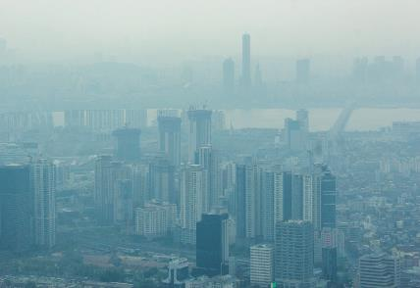
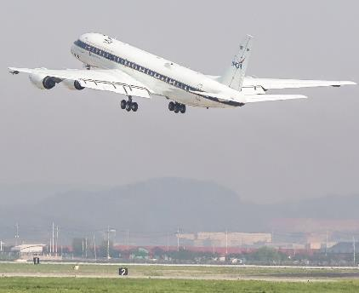

Question 2: Can we identify 1) what portion of aerosol is derived from secondary production in SMA and across Korea, 2) major sources and factors controlling its variation?
(Photos taken during KORUS-AQ flights by Sam Hall)
Notes:
Photos contributed by Sam Hall (NCAR) highlight the pervasive nature of aerosol and resulting hazy conditions during KORUS-AQ.

Slide 10
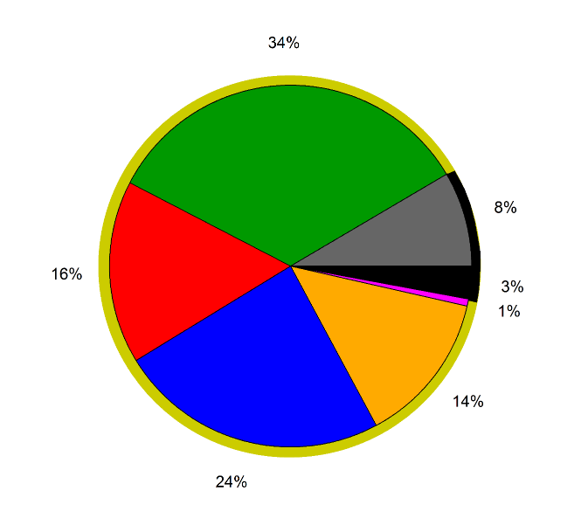
Preliminary Finding: The dominant fraction of PM2.5 is due to secondary production that is strongly influenced by emissions of NOx, SO₂, aromatic compounds, and ammonia.
Secondary Production = 27 μg/m³ (organic aerosol from chemistry + sulfate + nitrate + ammonium + chloride)
4 μg/m³ of PM from direct emissions (organic aerosol from direct emissions + black carbon)
Measurements from the NASA DC-8.
Notes:
Figure contributed by Ben Nault (UC-Boulder) showing average composition of fine aerosol measurements.

Slide 11
Preliminary Finding: While organic aerosol is the dominant PM2.5 species. Relatively larger fractions of nitrate aerosol in SMA as compared to the rest of the Korean peninsula indicates local production.
Figure comparing SMA aerosol composition with that of the greater peninsula observations
Taehyoung Lee

Slide 12
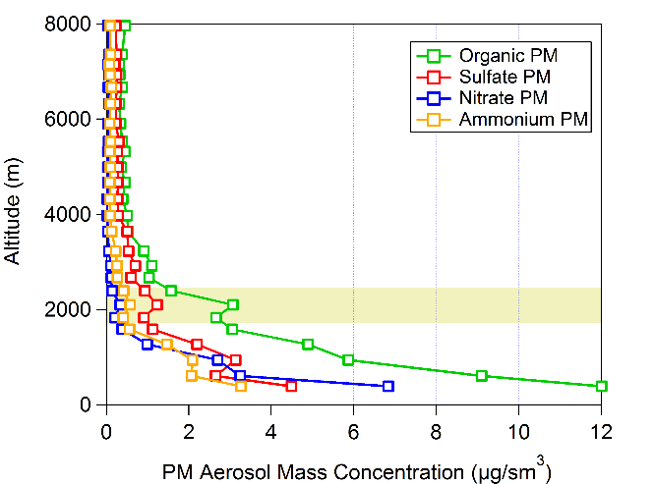
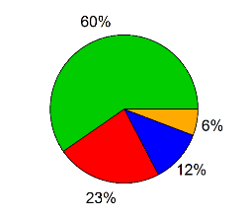
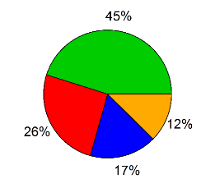
Preliminary Finding: The large-scale presence of an aerosol layer in the lower free troposphere with larger fractions of organic aerosol and sulfate suggest a stronger transport contribution to these components relative to nitrate.
Elevated aerosol layer above boundary layer shows different chemical composition than boundary layer. Average mass concentration = 5 μg/sm³.
Average boundary layer PM observed over Taewha during campaign. Average mass concentration = 27 μg/sm³.
Measurements from the NASA DC-8.
Notes:
Figures contributed by Ben Nault (CU-Boulder).

Slide 13
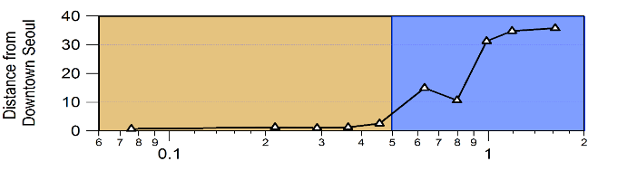
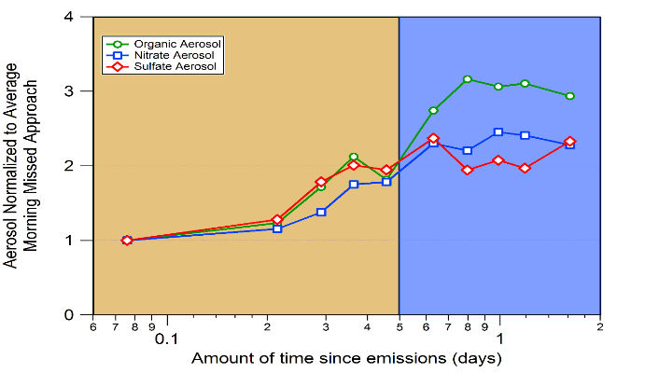
Preliminary Finding: Gradients of increased aerosol downwind of urban centers such as Seoul and Busan are consistent with local aerosol production.
Missed Approach Seoul
Downwind/Taewha
The organic, nitrate, and sulfate mass, when normalized for dilution and average morning values in Seoul, increase as the NASA DC-8 sampled downwind of Seoul.
The increase in mass is consistent with local aerosol production of all three species.
Measurements from the NASA DC-8.
Notes:
Figures contributed by Ben Nault (CU-Boulder)

Slide 14
Preliminary Recommendation: Continued aerosol monitoring at ground-based sites in Seoul and Taehwa could help to put boundaries on secondary aerosol production in the SMA
Missed Approach Seoul
Downwind/Taewha
The higher aerosol amounts seen by the DC-8 over Taehwa highlight the importance of continuously monitoring PM2.5 at Taehwa for comparison with measurements across other SMA sites in the AirKorea network.

Slide 15
Preliminary Recommendation: The importance of daytime secondary aerosol production calls for measurement integration times of an hour or less.
Figure showing increase in aerosol abundance and aerosol nitrate fraction for consecutive DC-8 profiles over Seoul
Taehyoung Lee
Would a ground-based time series from Olympic Park be better?

Slide 16
Question 3: Is ozone formation in SMA NOx limited or VOC limited? Can we determine the biogenic or natural contributions to ozone production?

Slide 17
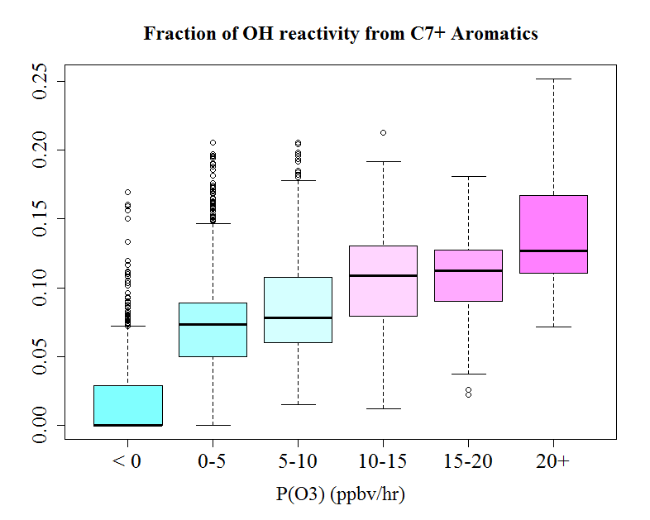
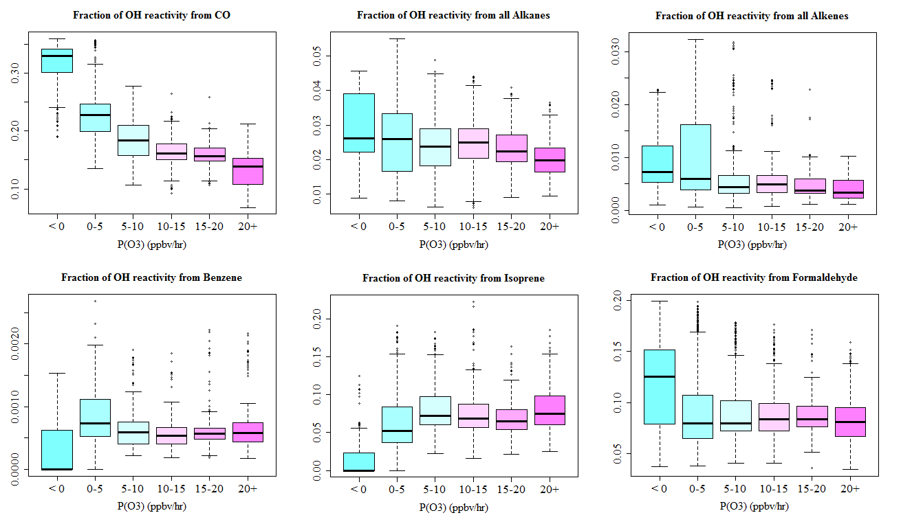
Preliminary Finding: Ozone production estimates for Seoul are most sensitive to changes in aromatic concentration
Confidence in model-derived estimates of ozone production requires further evaluation in comparison to observed ozone changes
Notes:
Figures contributed by Jason Schroeder (NASA LaRC)
The large figure on the left highlights the increasing fractional contribution of C7+ aromatics to OH reactivity in Seoul leads to an increasing contribution to ozone production. Data are binned across P(O₃) every 5 ppb/hr. Generally, the importance of aromatics becomes greater as P(O₃) increases.
The smaller figures on the right demonstrate that this trend is not observed for other hydrocarbon types.
These results are derived from the NASA LaRC Photochemical Box Model as constrained by DC-8 observations. These calculations will be further scrutinized by comparing ozone production estimates to observed changes in ozone over Seoul as well as model predicitions of other measurements (e.g., radical, formaldehyde, hydrogen peroxide, etc.). This analysis will be used to place better uncertainty estimates on the model-derived estimates.

Slide 18
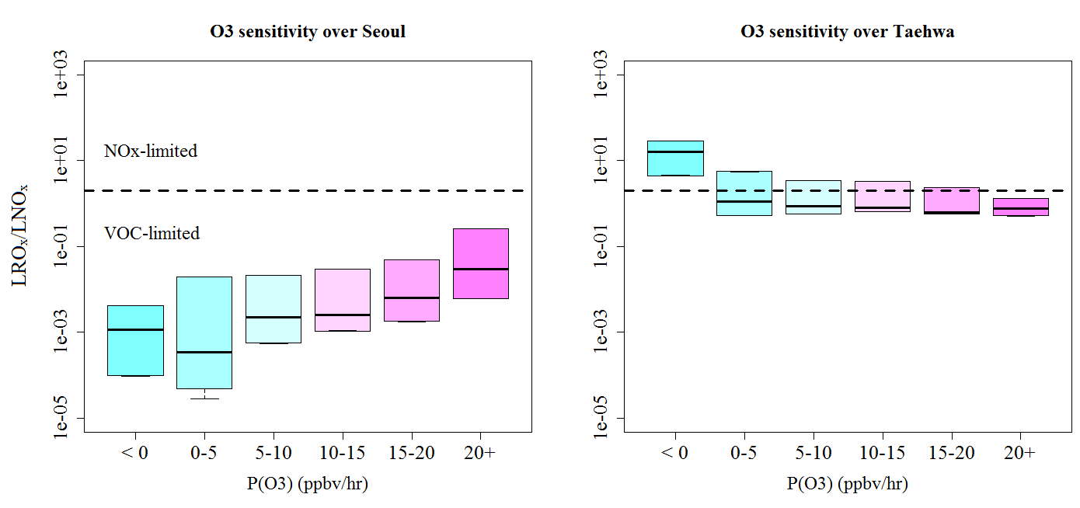
Preliminary Finding: While ozone production in Seoul is estimated to be VOC-limited, reduction in ozone across SMA and downwind regions will be best achieved by reductions in both VOCs and NOx
Confidence in model-derived estimates of ozone production requires further evaluation in comparison to observed ozone changes
Notes:
Figure contributed by Jason Schroeder (NASA LaRC)
These figures use the metric LROx/LNOx that has been traditionally used to determine NOx versus VOC limitations on ozone production. The ratio compares rates for radical chemistry termination due to NOx reactions versus peroxy radical self reactions. In the left panel, estimates over Seoul are clearly in the VOC-limited regime while results over Taehwha are near the transition. This shift can be attributed to the more rapid reduction of NOx in the polluted air transported out of Seoul due to a shorter lifetime versus VOCs as well as continued inputs from biogenic VOCs downwind of the city. This demonstrates that when considering the larger SMA domain, controls of both NOx and VOC will help reduce ozone production.
These results are derived from the NASA LaRC Photochemical Box Model as constrained by DC-8 observations. These calculations will be further scrutinized by comparing ozone production estimates to observed changes in ozone over Seoul as well as model predicitions of other measurements (e.g., radical, formaldehyde, hydrogen peroxide, etc.). This analysis will be used to place better uncertainty estimates on the model-derived estimates.

Slide 19
Preliminary Finding: Both ozone and secondary aerosol formation appear to be driven by common emission sources
Need graphic comparing Olympic Park and Taehwa for ozone, NOx, HCHO, aerosol abundance and composition – diurnal profiles?
Ben Nault and John Sullivan

Slide 20
Preliminary Finding: Natural contributions to ozone production are driven by biogenic VOCs from vegetation and become more important downwind of Seoul
Diurnal variability in O3, Ox (O3 + NO2), and HCHO for Olympic Park (OLY) and Taehwa Research Forest (TRF)
Notes:
Figures contributed by John Sullivan (NASA GSFC)
Surface observations between Olympic Park (OLY) and Taehwa Research Forest (TRF) provide an example of the biogenic VOC contribution from vegetation on ozone. The top panel denotes the difference in maximum daily 1-hr O3 between sites, indicating TRF had substantially higher 1-hr maximums in O3 for many days during the KORUS-AQ campaign period. The TRF site exceeded the 100 ppbv NIER standard for 1-hr maximum O3 on 11 days, whereas OLY only exceeded 100 ppbv on 3 days. The average diurnal concentrations of O3, Ox (O3 + NO2) and HCHO are shown in the bottom panel. During afternoon and evening hours (12:00-20:00 KST), O3 is generally 10-15 ppbv higher at TRF than at OLY. In total odd oxygen, there are very similar concentrations throughout the daytime hours, indicating the large differences observed in O3 are likely photochemically produced en route to the TRF site. During daytime hours, HCHO (a measure of hydrocarbon oxidation), is also mostly within 1 ppbv between the sites, indicating oxidation of VOCs has occurred. This suggests that continued VOC oxidation, from local sources of biogenic VOCs such as isoprene in forested regions, were active during the daytime at TRF. This process is a known source of OH radicals and can foster O3 production. Although specific days during the campaign may have larger variability between the sites, these averaged diurnal plots provide evidence for the long-term downwind plume chemistry intensifying O3 contributions at TRF from Seoul.

Slide 21
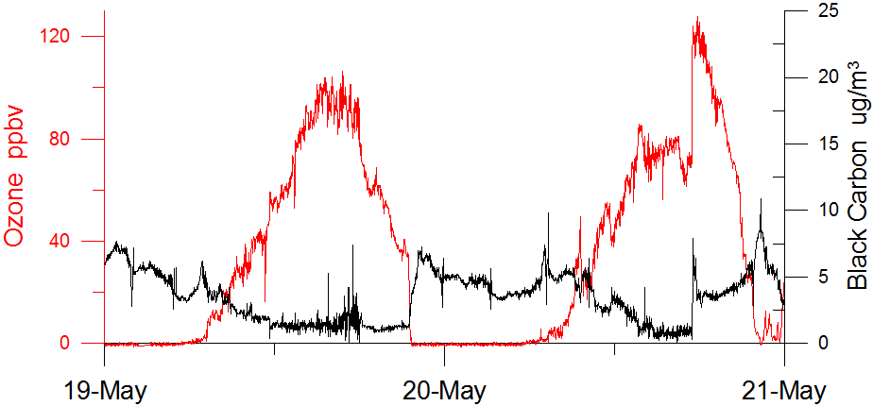
Preliminary Finding: Coastal sea breezes and local topography affect circulation of pollutants making it difficult to forecast the timing and location of exposure to unhealthy ozone and PM2.5 levels.
Frontal Extreme Air Quality Changes
R. Long (O₃) and J. Lee(BC)
Notes:
Figure contributed by Gangwoong Lee (HUFS)
The time series shown for ozone and black carbon at Olympic Park highlights how rapidly conditions can change with ozone changes of 40 ppbv and black carbon changes of an order of magnitude. These shifts are also accompanied by large changes in ozone and aerosol precursors (not shown) and demonstrate how these circulations can lead to extreme gradients in pollution levels that make it difficult to accurately predict the location and timing of pollution events across SMA.

Slide 22
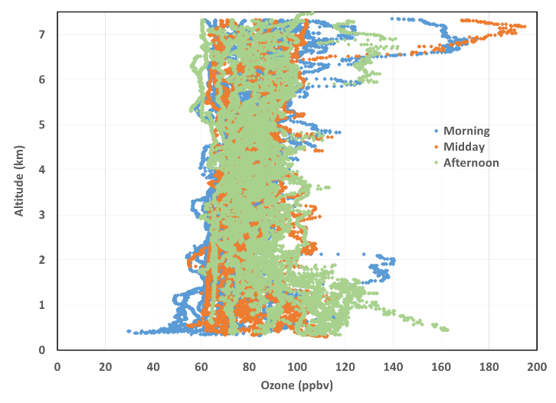
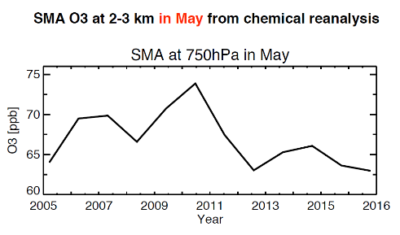
Preliminary Recommendation: Ozone in the lower free troposphere during KORUS-AQ was always greater than 60 ppbv. Thus, continued observations of ozone aloft over SMA are necessary for understanding future ozone changes at the surface and the effectiveness of local control strategies.
Median = 79 ppbv
Notes:
Figures contributed by Jim Crawford (NASA LaRC) and Kazuyuki Miyazaki (NASA JPL)
The left panel shows all ozone measurements collected during 52 profiles conducted SE of Seoul in the vicinity of Taehwa. The photochemical influence on ozone is clear in the lowest 2 km based on changes from morning to afternoon. In the lower free troposphere just above (2-3 km), there is no evident trend with time of day and ozone is persistently greater than 60 ppbv with a median value that is much higher (79 ppbv). Thus continued monitoring of this background ozone aloft is important to assessing the effectiveness of local ozone controls.
The panel on the right represents interannual variability in ozone aloft over SMA based on model reanalysis including satellite data assimilation. These results indicate interannual variability and a trend of decreasing ozone. Observations are needed to verify whether this trend continues and how it aids in reducing local ozone across SMA and Korea.

Slide 23

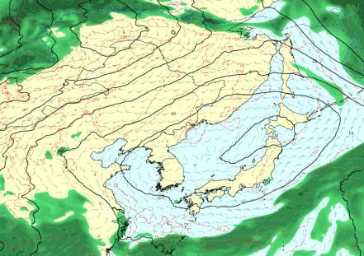
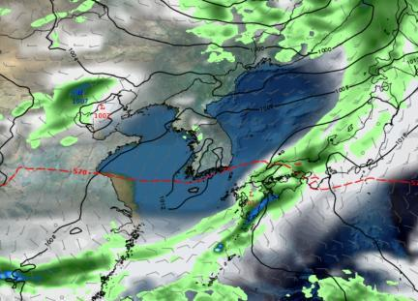
Question 4: How is SMA affected by transport of air pollution from sources from regional to continental to hemispheric scales?
Stagnant 5/17-5/22 (Persistent High Pressure)
Transport 5/25-5/28 (Series of Weak Fronts)
Secondary Weak Front
Transport Enhanced
Transport Diverted
H
Primary Front
Stagnant
Notes:
Figure contributed by Dave Peterson (NRL-Monterey)
During the KORUS-AQ campaign, a period of stagnation (left panel) followed by a period of transport (right panel) provided an excellent comparison of the response of Korean air quality to transport influences. These periods will be highlighted in the following slides.

Slide 24
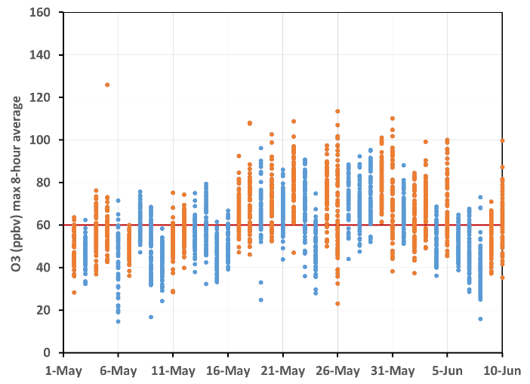
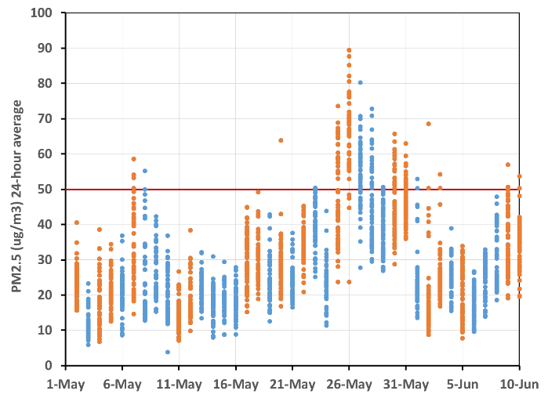
Preliminary Finding: Exceedances for PM2.5 and ozone can occur during periods of both strong and weak influence from long-range transport.
Max 8-hr average Ozone
24-hour average PM2.5
Flight Days
Non Flight Days
Korean AQ Standard
Flight Days
Non Flight Days
Korean AQ Standard
The daily distribution of AirKorea values for ozone and PM2.5 show differing behavior with respect to periods of stagnation (yellow shading) and transport (green shading).
Notes:
Figures contributed by Jim Crawford (NASA LaRC)
The left panel shows that ozone rose substantially during the stagnant period, but these high ozone values persisted in spite of meteorological changes over the following weeks. The right panel, however, shows that the largest PM2.5 levels coincide with the transport period.

Slide 25
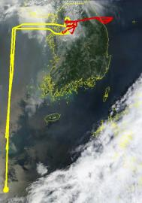
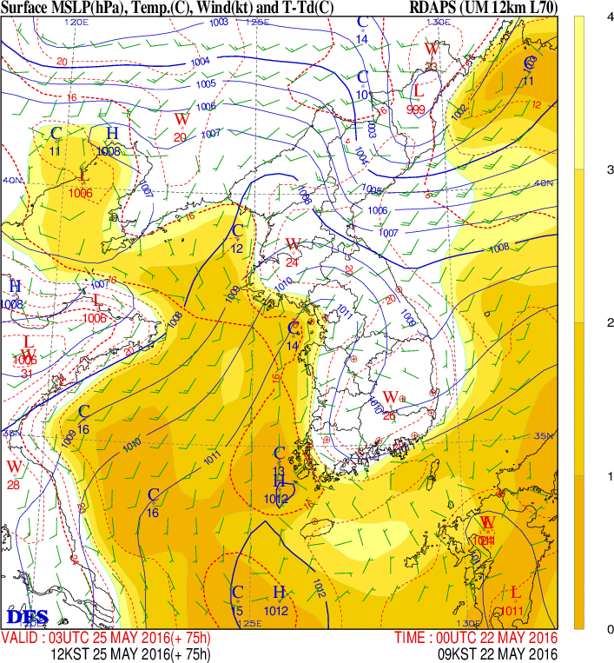
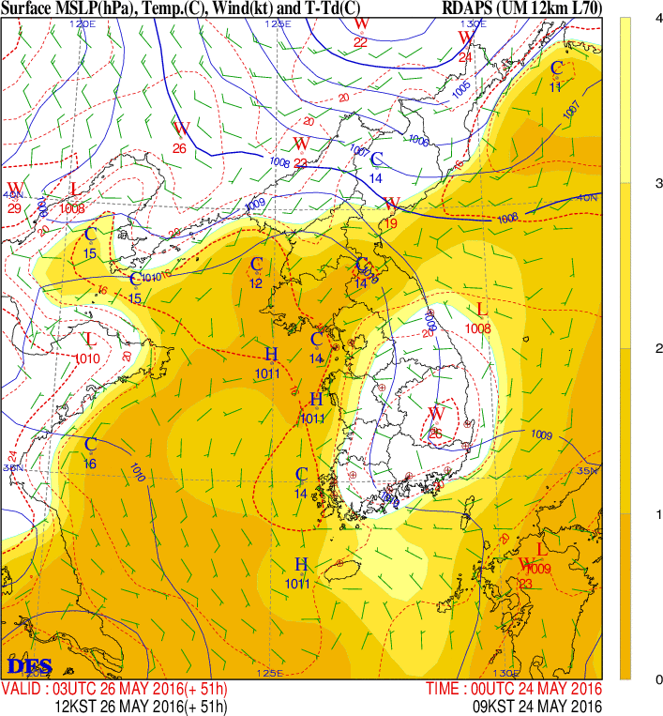
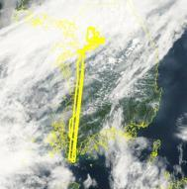
Preliminary Finding: KORUS-AQ documented increases in PM2.5 from long range transport during 26-28 May
Surface Map: 5-25-16 (03 UTC, 12 KST)
Surface Map: 5-26-16 (03 UTC, 12 KST)
5/25
Dry
Weak Front
Approaching
front
Moist
Moist
5/26
Notes:
Figures contributed by Dave Peterson (NRL-Monterey)
These figures highlight the meteorology behind the transport effects on PM2.5 shown on the next slide.

Slide 26
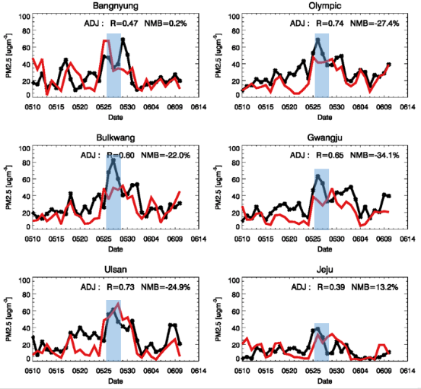
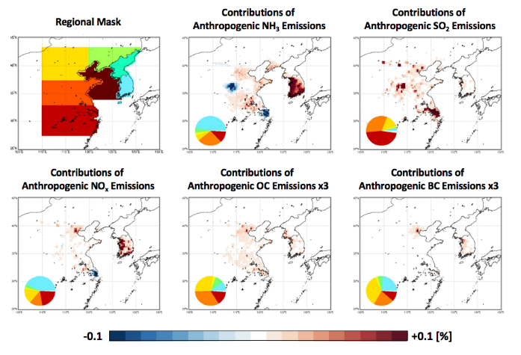
Preliminary Finding: KORUS-AQ documented increases in PM2.5 from long range transport during 26-28 May
*
Observation Simulation
Notes:
Figures contributed by Rokjin Park (SNU)
Model analysis of the PM2.5 enhancement due to transport shows large external contributions to sulfate and organic aerosol; however, half of nitrate and ammonium are still from local sources. This suggests that local controls on NOx and ammonia have the best chance to affect PM2.5 with regard to local contributions.

Slide 27
Preliminary Finding: Local sources contribute to air quality violations even when under the influence of long range transport.
Graphic showing increase in nitrate aerosol fraction over Seoul during the 26-28 May period impacted by long-range transport.
Taehyoung Lee

Slide 28
Preliminary Finding: External influences on air quality are the result of direct transport of ozone and PM rather than precursors
Need graphic showing lack of precursors in presence of elevated ozone and PM in the lower free troposphere.
Jim Crawford

Slide 29
Preliminary Finding: Because of high background ozone, current 8-hour ozone standards are unattainable without background decreases
2006 2007 2008
2010 2011 2012
2013 2014 2015 2016
Further analysis is needed to see how 2-3 km ozone varies with transport
Notes:
Figures contributed by Kazuyuki Miyazaki (NASA JPL)
The chemical reanalysis of ozone based on assimilation of satellite data demonstrates that the high background ozone is decreasing with time. If this trend persists, regional improvements in air quality will complement local efforts on Korea to curb emissions contributing to poor air quality across east Asia

Slide 30
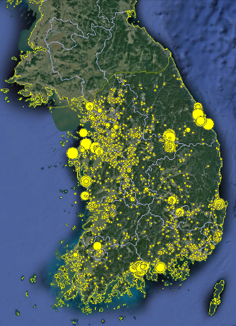
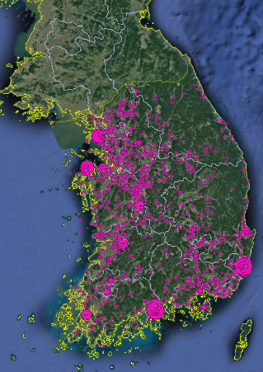
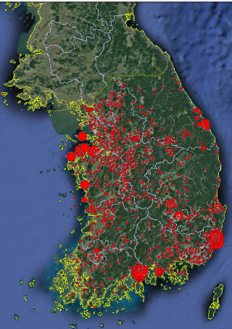
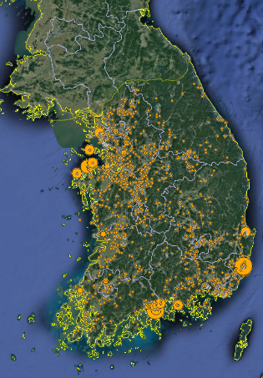
Question 5: How well do KORUS-AQ observations support current emissions estimates (e.g., NOx, VOCs, SOx, NH₃) by magnitude and sector?
NOx VOCs SOx NH₃
Notes:
These data contributed by Jung Hun Woo (Konkuk University) represent point source emission estimates across Korea that must be considered along with mobile and area sources to understand the full picture regarding ozone and PM precursors.

Slide 31
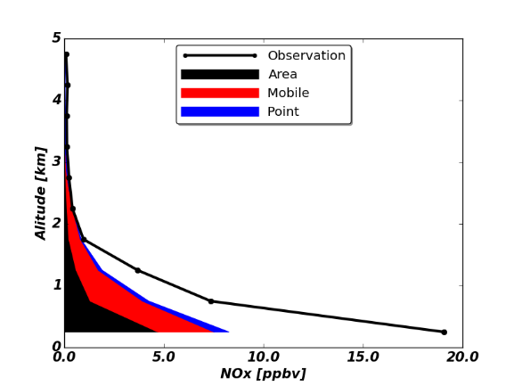
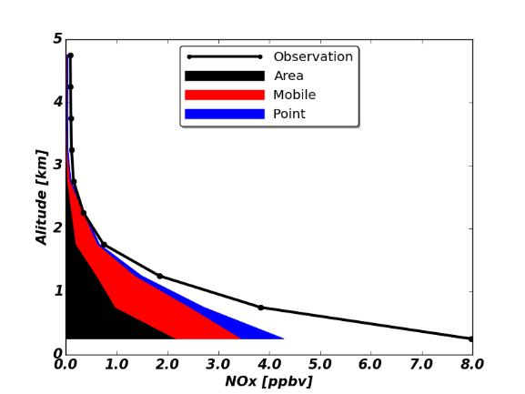
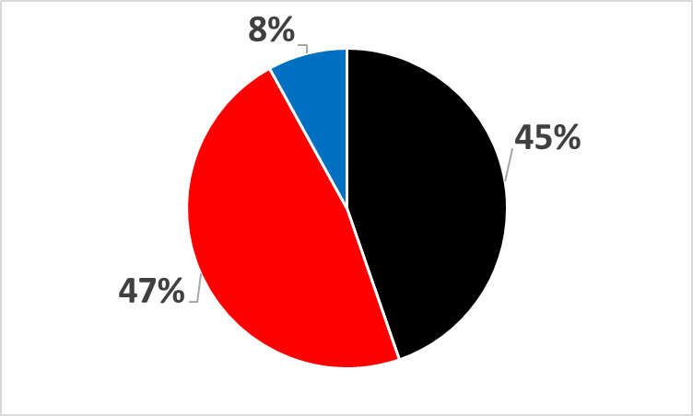
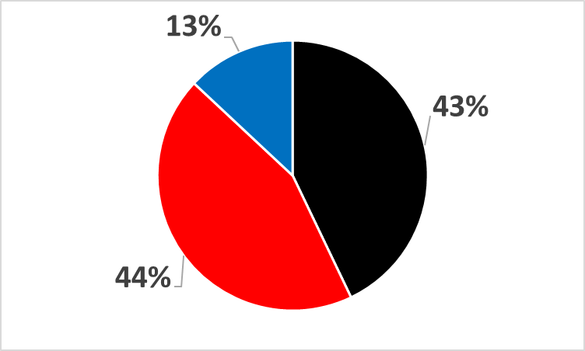
Preliminary Finding: Observations taken by the DC8 and ground sites are consistent with a dominant influence from transportation NOx in urban areas.
SMA
Korean peninsula
Model
Model
Notes:
Figures contributed by Rokjin Park (SNU)
These figures compare model and observed NOx levels during KORUS-AQ with modeled values apportioned by source. While transportation makes up a large fraction, modeled quantities far substantially short of observations which are underestimated by 50% for SMA and 37% for the South Korean peninsula.

Slide 32
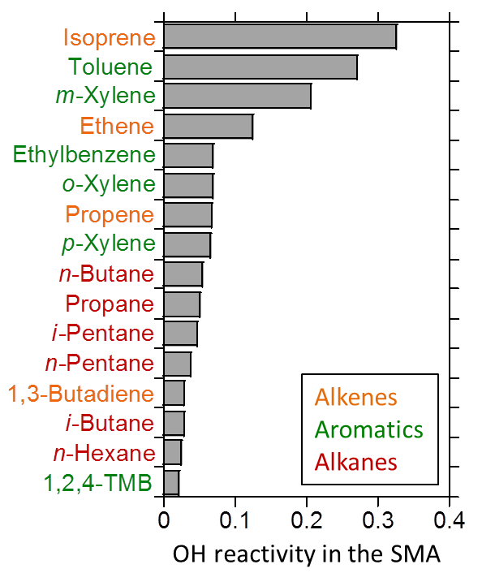
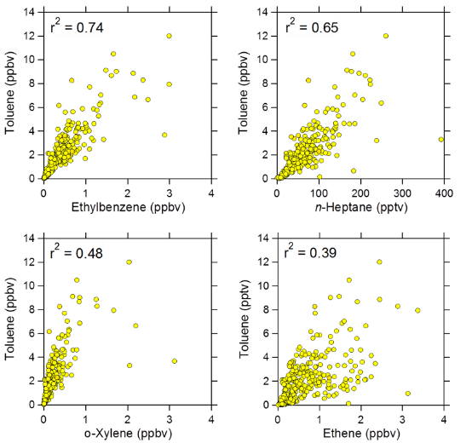
Preliminary Finding: The large abundance of highly reactive organic compounds, while consistent with solvent use for the aromatics, has not been positively attributed (other candidate sources may exist).
Notes:
Figures contributed by Isobel Simpson (UC-Irvine)
Aromatics and alkenes make up the largest fraction of OH reactivity in the Seoul Metropolitan Area (SMA), based on non-oxygenated VOCs that were measured during KORUS-AQ.
(2) Isoprene did not correlate well with traffic tracers in the SMA, consistent with its biogenic source.
(3) In urban areas, ethene and propene are combustion products typically associated with vehicular exhaust.
(4) While the alkene sources can be attributed fairly readily, the aromatics require further analysis such as source apportionment to clarify their sources.
(5) Based on Hong Kong data, strong toluene correlations with ethylbenzene and the xylenes indicate architectural paints; additional correlations with benzene, n-hexane and n-heptane indicate consumer products and printing; and correlations with ethene, propene, etc. indicate vehicular exhaust (Ou et al., 2015).
(6) Early analysis shows that toluene correlated poorly with traffic tracers such as ethene and propene in the SMA.
(7) Stronger toluene correlations with ethylbenzene, n-hexane and n-heptane suggest multiple solvent sources.
(8) Weaker toluene correlations with the xylenes raises the possibility of additional xylene sources (for example, xylenes dry more slowly than toluene and can be used in different solvent applications).

Slide 33
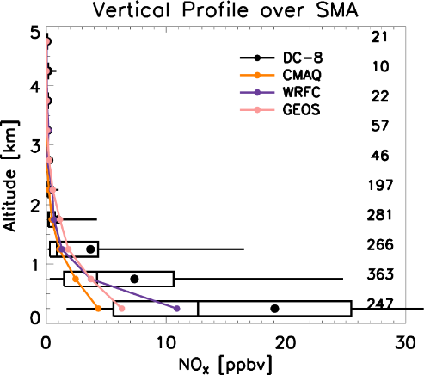
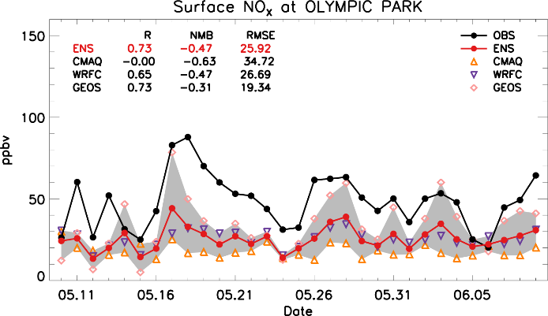
Preliminary Finding: The magnitudes of NOx emissions and key reactive VOCs (e.g. toluene) are underestimated in the current inventory for SMA
Notes:
Figures contributed by Rokjin Park (SNU)
Results are shown from an ensemble of models demonstrating that models consistently underestimate NOx in SMA. While the degree of underestimation varies, the persistently low values point to the emissions inventory as a common contributor.

Slide 34
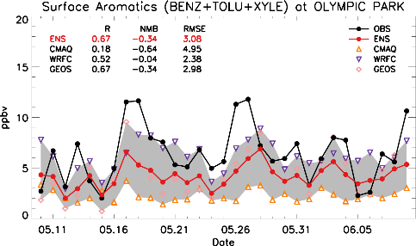
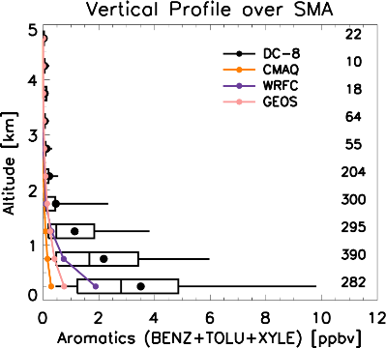
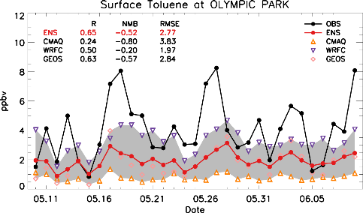
Preliminary Finding: The magnitudes of NOx emissions and key reactive VOCs (e.g. toluene) are underestimated in the current inventory for SMA
Notes:
Figures contributed by Rokjin Park (SNU)
Results are shown from an ensemble of models demonstrating that models consistently underestimate reactive VOCs (in this case, aromatics) in SMA. While the degree of underestimation varies, the persistently low values point to the emissions inventory as a common contributor.

Slide 35
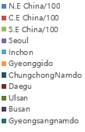
Preliminary Recommendation: VOC emissions should be evaluated in terms of reactivity and potential aerosol yield to fully understand the consequences of the emissions
Pie charts comparing relative importance of VOCs by abundance and by reactivity - Jung Hun Woo
SOA formation
from NMVOCs Emissions (ARO1)
NMVOCs Emissions
by abundance(mole)
NMVOCs Emissions
by reactivity
Notes:
Figures contributed by Jung Hun Woo (Konkuk University)

Slide 36
Preliminary Recommendation: In addition to NOx and VOCs, knowledge of the abundance of ammonia and knowledge of diurnal variation in its sources should be emphasized.
Pie chart of anions/cations
Taehyoung Lee

Slide 37
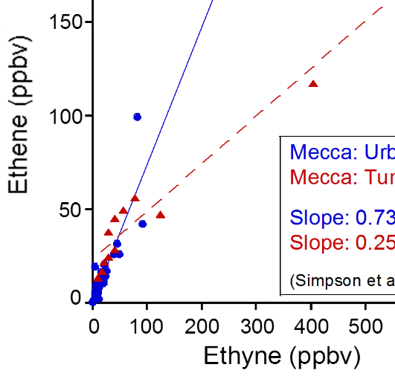
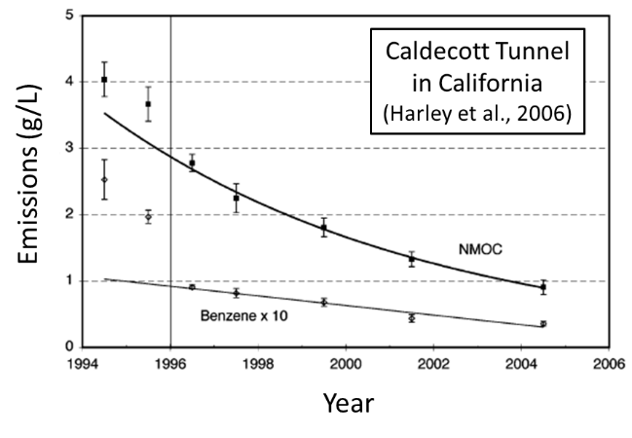
Preliminary Recommendation: Emissions discrepancies need to be reconciled with specific knowledge on the implementation of controls. For example, collection of observations in tunnels would be an effective way to isolate emissions from traffic versus other sources.
Notes:
Figures contributed by Ron Cohen (UC-Berkeley) and Don Blake (UC-Irvine)
VOCs are emitted from different sources in characteristic ratios (e.g., McGaughey et al., 2004; Gilman et al., 2013; Simpson et al., 2014).
(2) Example 1: an i-butane/n-butane ratio of 0.2-0.3 indicates vehicular exhaust, while a ratio of 0.42-0.46 indicates liquefied petroleum gas (LPG).
(3) Example 2: an i-pentane/n-pentane ratio of 3-4 indicates gasoline evaporation, while a ratio of 0.8-0.9 indicates natural gas.
(4) Example 3: an ethene/ethyne ratio of 10-30 indicates petrochemical sources, a ratio of 1-3 indicates vehicle exhaust, and a ratio <1 indicates exhaust from older or poorly maintained vehicles.
(5) Tunnel studies in Seoul would allow VOC ratios specific to the current Seoul traffic fleet to be characterized.
(6) This information would help to distinguish Seoul traffic sources from other local sources.
(7) Long-term tunnel monitoring would also show how traffic emissions of VOCs and other compounds are changing over time in response to emission controls (e.g., Harley et al., 2006).

Slide 38

Preliminary Finding: KORUS-AQ measurements and their interpretation through analysis and modeling work will provide a path for improvement in emissions estimates and recommendations for future work. Inverse modeling in the near-term will play a key role.
Notes:
Figure contributed by Jay Al-Saadi and Laura Judd (NASA LaRC)
This animation of four consectutive overflights mapping the distribution of NO2 over SMA demonstrate the dynamically changing atmospheric abundance. These changes are useful for understanding the connection between sources (both are and point) and their local and nonlocal impacts. Inverse modeling of these observations can be useful in constraining different emission sectors.

Slide 39


KORUS-AQ serves as preparation for the launch of GEMS and the full implementation of an integrated observing strategy for Air Quality.
Notes:
Graphics contributed by Jim Crawford (NASA LaRC) demonstrating how multi-perspective observations during KORUS-AQ were used to exercise and evaluate integrated observations in the way that will become more routine after the launch of GEMS. The image on the right shows the GEMS field of view with long-term average NO2 from OMI. The hourly observations provided by GEMS will represent a breakthrough for satellite observations needed to understand the interplay of changing emissions, dynamics, and chemistry in determining air quality.

