Slide 1

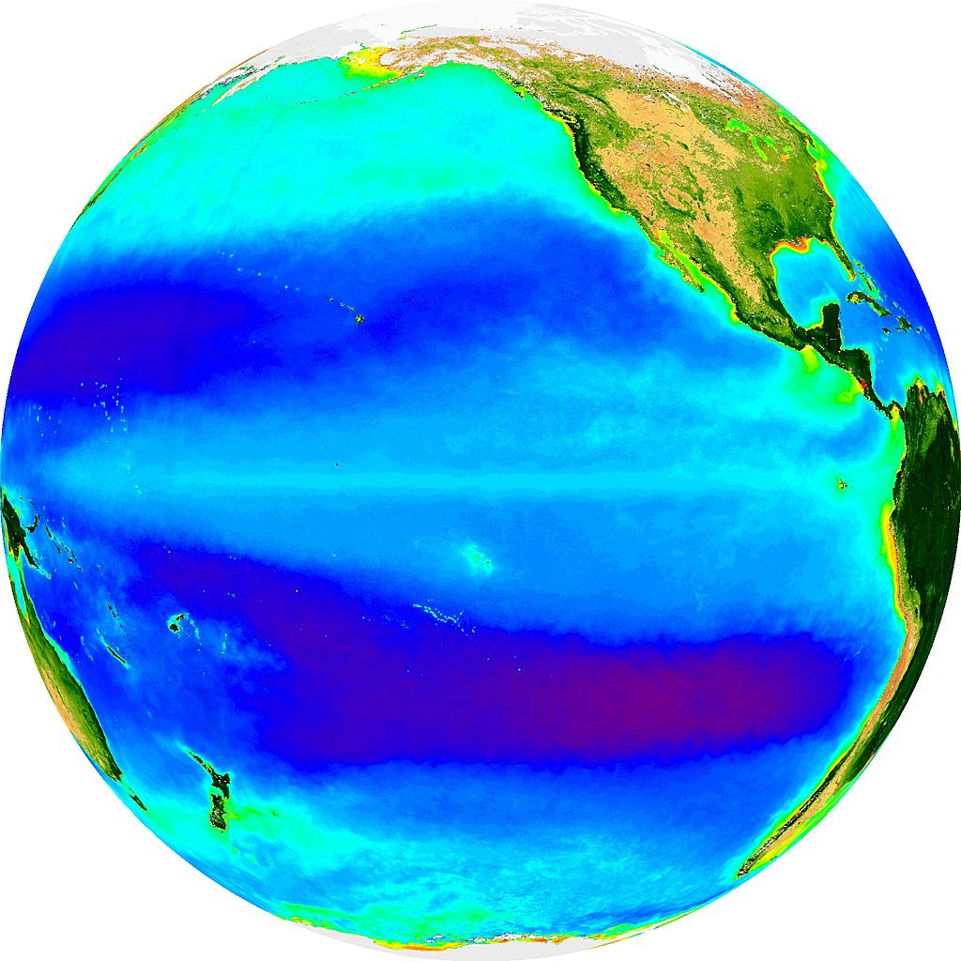
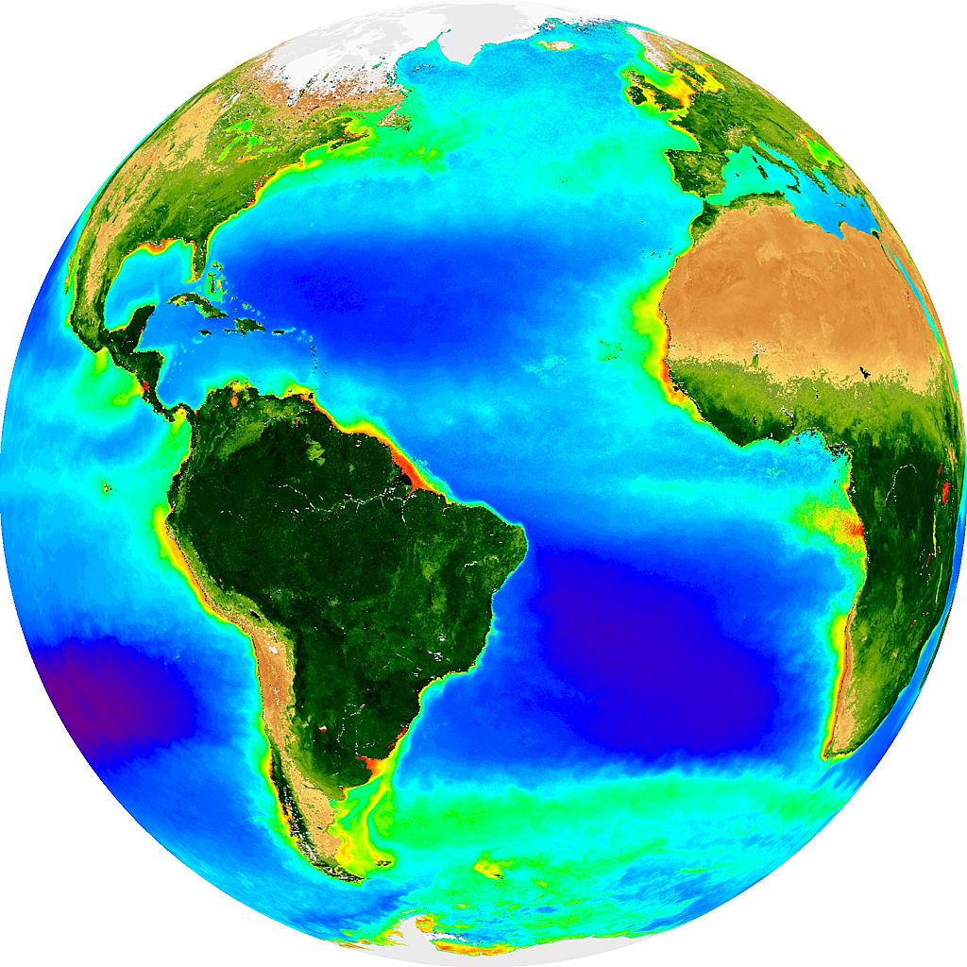
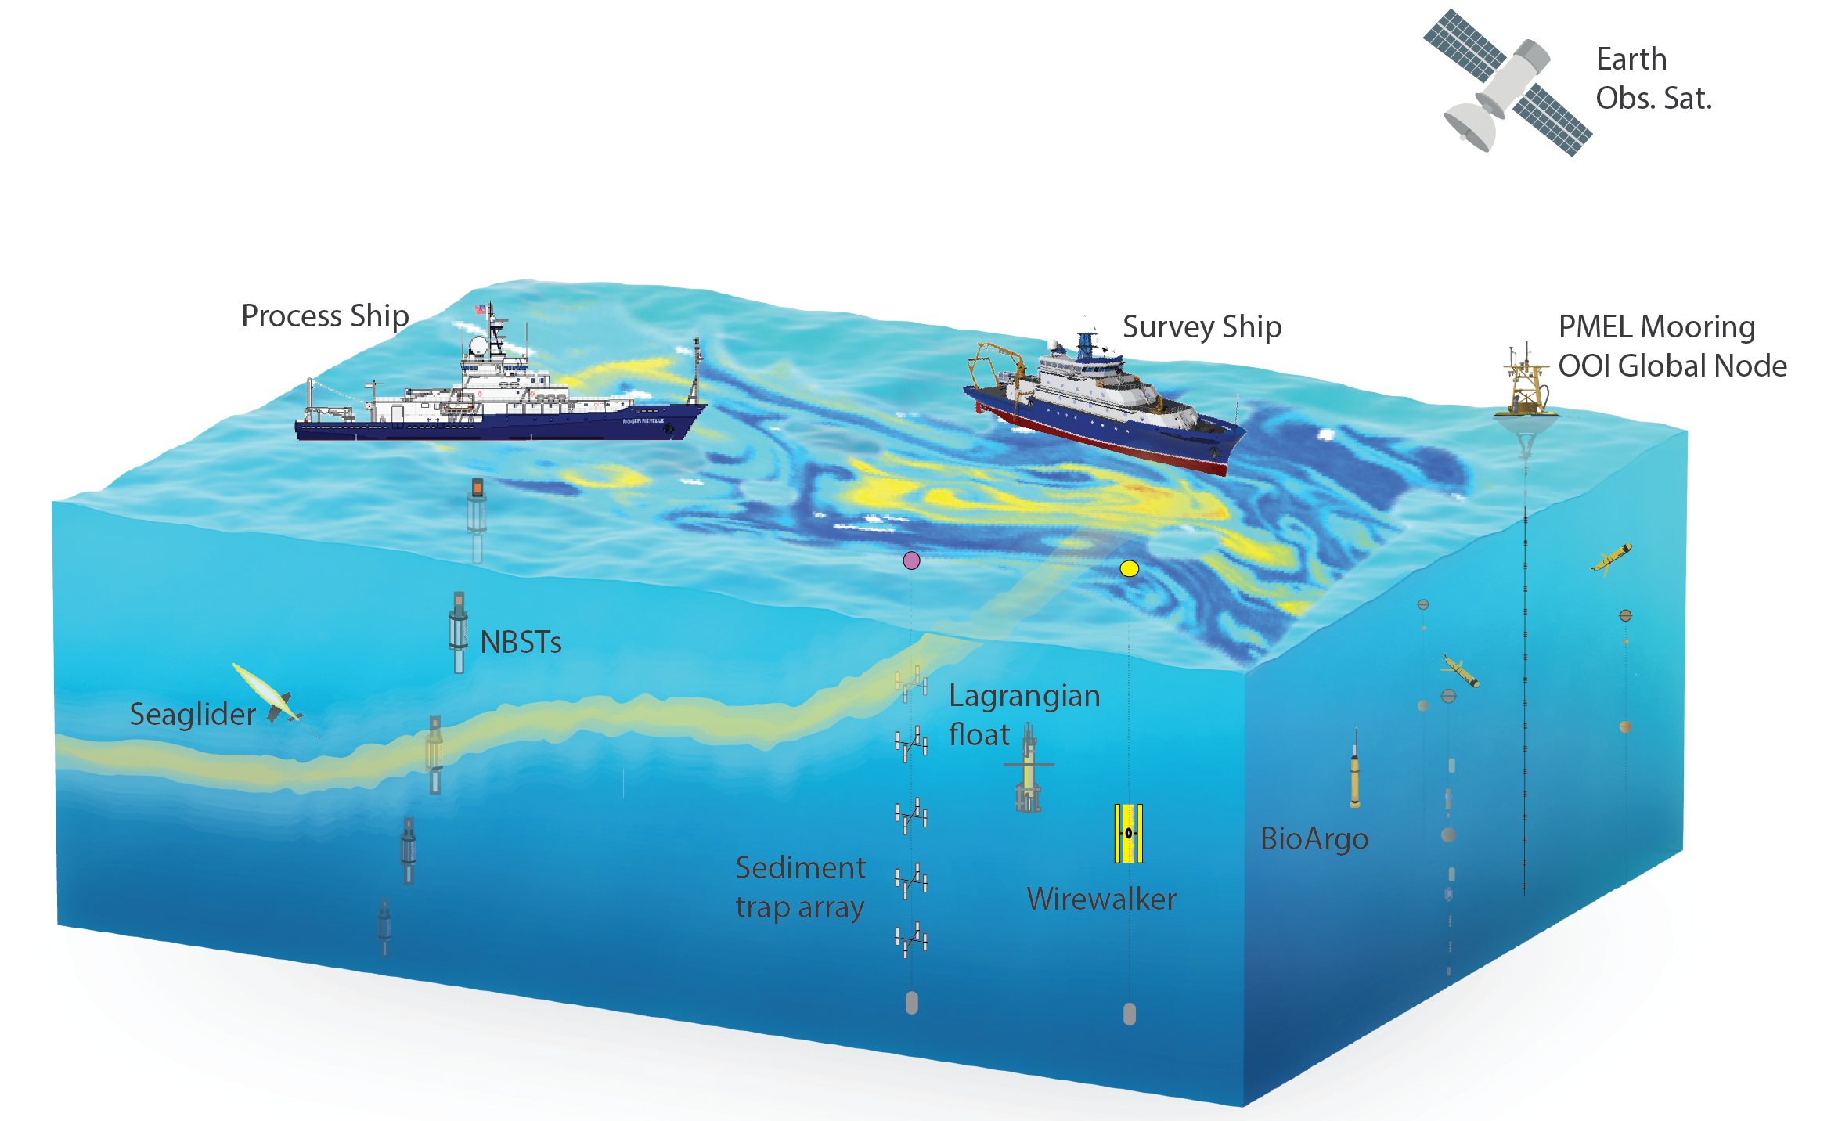
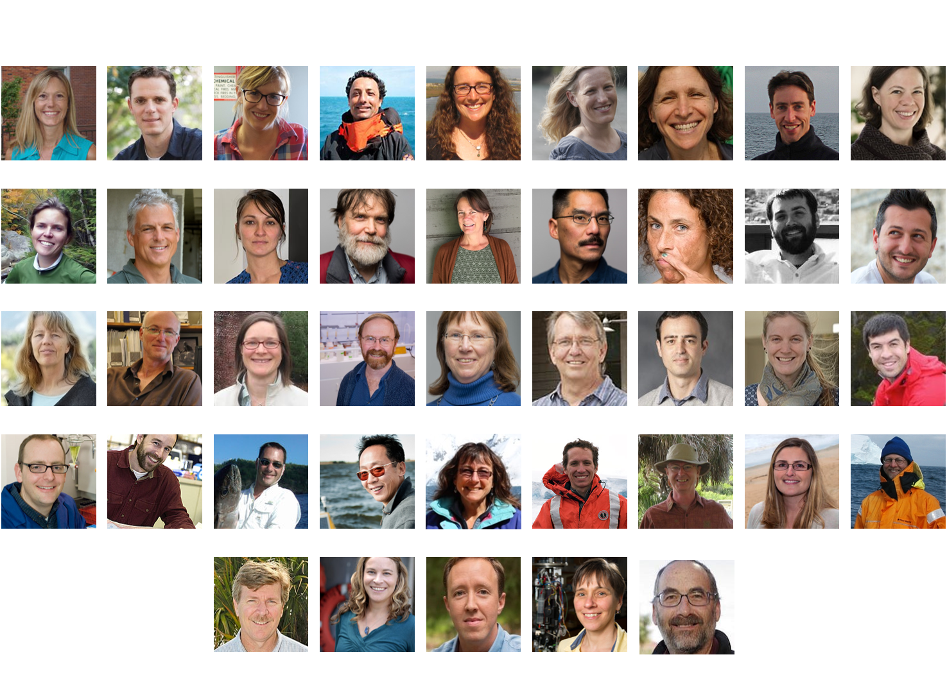
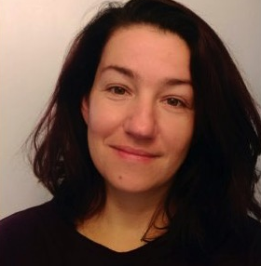
EXport Processes in the Ocean from RemoTe Sensing – EXPORTS
Status and Plans for its First Cruise to the Northeast Pacific Ocean
David A. Siegel, Ivona Cetinic & the EXPORTS Science Team
Goal & Hypothesis
Overall Project Plans
EXPORTS Field Science Team
The NE Pacific Cruise
EXPORTS’s goal is to improve predictions of the export and fate of ocean NPP using satellite data and numerical models.
  Advances in remote sensing, genomics, in situ imaging & autonomous tools make achieving this goal possible
  EXPORTS’ focus is on the quantifying the export pathways of upper ocean NPP over a range of biogeochemical states
Hypothesis: Carbon export from the euphotic zone and its fate within the twilight zone can be predicted knowing characteristics of the surface ocean ecosystem.
NASA is planning a two cruise field program followed by a modeling and synthesis phase
  The first phase for the EXPORTS field science team has been competed by NASA
  NSF has recommended several additional projects for support
  The first cruise will sail to Station P while a second is planned to sail to the North Atlantic
  A coordinated sampling program is planned with two ships and several autonomous vehicles
Project Investigators | Measurements & Platform
Michael Behrenfeld (OSU), Emmanuel Boss (UMaine), Jason Graff (OSU), Lionel Guidi (LOV), Kim Halsey (OSU), & Lee Karp-Boss (UMaine) | Phytoplankton Biomass, Community Composition & Rates Particle / Aggregate Size Distribution IOP & AOP UW & Profiling Process Ship
Ken Buesseler (WHOI), Claudia Benitez-Nelson (USC) & Laure Resplandy (Princeton) | Thorium-234 Export & Fractionated Pumping from Survey Ship Submesoscale Phys-BGC Modeling
Craig Carlson (UCSB) & Dennis Hansell (RSMAS) | DOC on both ships DOM Quality & Bioavailability & Bacterial Production on Process Ship
Meg Estapa (Skidmore), Ken Buesseler (WHOI), Colleen Durkin (MLML) & Melissa Omand (URI) | Neutrally & Surface Tethered Sediment Trap Fluxes Wirewalker Autonomous Profiler Deploy from Process Ship
Craig Lee (UW), Eric D’Asaro (UW), David Nicholson (WHOI), Melissa Omand (URI), Mary Jane Perry (self) & Andrew Thompson (CalTech) | Lagrangian Float & Seaglider deployment & analyses Reference frame for Process Ship & ~6 month temporal context Construct sensor-based BGC proxies
Adrian Marchetti (UNC), Nicolas Cassar (Duke) & Scott Gifford (UNC) | NCP via O₂/Ar (Both Ships) New & regen PP and community & bacterial respiration (Process Ship) 18S/16S rDNA community structure Metagenomics phyto physiology
Susanne Menden-Deuer (URI) & Tatiana Rynearson (URI) | Phyto growth & µZoo grazing rates Phyto / µZoo taxonomic composition MacroZoo gut content grazing Process ship
Collin Roesler (Bowdoin) & Heidi Sosik (WHOI) | Underway size-fractionated IOPs & hyperspectral reflectance spectra Single cell imaging & enumeration Survey Ship
David Siegel (UCSB), Adrian Burd (UGA), Andrew McDonnell (UAF), Norm Nelson (UCSB) & Uta Passow (UCSB) | In situ particle size spectra using LISST & UVP (Both Ships) Marine snow characterization (Process Ship) Core hydrographic analyses (Both Ships) Aggregate dynamics modeling
Deborah Steinberg (VIMS) & Amy Maas (BIOS) | Zooplankton abundance, respiration & fecal pellet production (Process Ship) Quantify export by zoop migration MOCNESS, UVP & acoustics
Xiaodong Zhang (UND), Deric Gray (NRL), Lionel Guidi (LOV) & Yannick Huot (Sherbrooke) | Particle size & density distributions from 20 nm to 2 cm via inversion of light scattering & imaging data Survey Ship
Bethany Jenkins (URI), Mark Brzezinski (UCSB) & Kristen Buck (USF)* | Diatom growth w/ nutrient additions Uptake of Fe/NO₃/Si & NPP by size Cellular Si deposition rates Metatranscriptomic metabolism proxies (all on Process Ship)
Ben Van Mooy (WHOI)* | Lipidomics of sinking & suspended particles (samples from Process Ship)
Andrea Fassbender (MBARI)* | Biogeochemical Profiling Floats Continue Station P long-term record
EXPORTS will improve predictions of the export, fate & C cycle impacts of ocean NPP from satellite data and numerical models.
  Advances in remote sensing, genomics, in situ imaging & autonomous tools make achieving this goal possible
  EXPORTS’ focus is on the quantifying the export pathways of upper ocean NPP over a range of biogeochemical states
Hypothesis: Carbon export from the euphotic zone and its fate within the twilight zone can be predicted knowing characteristics of the surface ocean ecosystem.
First cruise will sail to Station P (50ºN 145ºW)
Leverages long-term sampling by Canada’s Line P program, NOAA PMEL’s Ocean Climate Mooring and the OOI global node
Unique site with Fe-limitation for phytoplankton growth & low mesoscale energy levels
R/V Revelle & R/V Ride set sail August 2018 with 27 days of sampling planned
Station P
NAtlantic
Science Questions
Q1:How do the characteristics of upper ocean ecosystems determine the vertical transfer of organic matter from the well-lit surface ocean?
Q2: What controls the efficiency of vertical transfer of organic matter below the well-lit surface ocean?
Q3: How can the knowledge gained be used to reduce uncertainties in contemporary & future estimates of the export and fates of NPP?
Timeline
A Coordinated Experiment
A process ship (R/V Revelle) measuring rates and time series of stocks follows a Lagrangian float
A survey ship (R/V Ride) provides spatial information of ocean optics & biogeochemistry
An autonomous glider will survey about the process ship and a BioArgo float will provide a long-term perspective
Coordinated sampling plan enables all export pathways to be quantified along with the data needed predict them from satellite observations
See EXPORTS Field Science Team table on the left for further details on measurements to be made
EXPORTS Field Program
… requires multiple ships (process, survey and vehicle launch/retrieval), autonomous platforms (gliders and floats) within a framework of remote sensing and modeling activities.
Focus on Pathways
On-Going Planning
EXPORTS Field Science Team
The Science Team is developing plans for…
Each platform (ships & AUV)
    - operational plans for each field component
Each parameter group (export pathway, biological rates, optics, particle composition & BGC stocks)
    protocol documents for each observable
    head start on metadata construction as well as fostering intergroup collaboration
situational awareness
    adaptive sampling & emergency planning
    interplatform communication is critical
data / sample management
        Ensure long-term legacy of the field efforts
EXPORTS website - www.oceanexports.org
* Project recommended for funding by NSF
BN14D-1055

