Slide 1
Science Team Telecon (13/14 March 2023)
Agenda
Brief status report on ASIA-AQ and prospects for candidate deployment sites
Introduction of Korean contributions through SIJAQ
Overview of NASA aircraft, payloads, and investigators
DC-8 Team introduction and tentative schedule
Discussion and questions

Slide 2
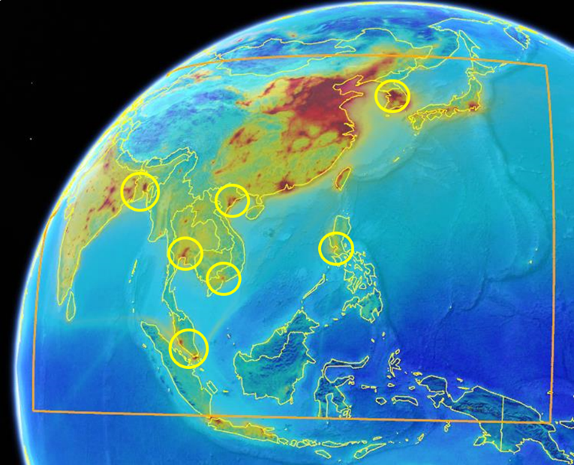
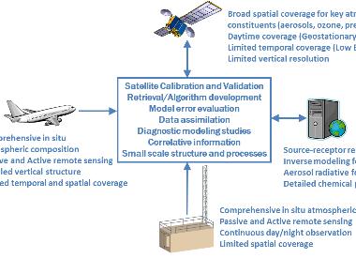
Airborne and Satellite Investigation of Asian Air Quality (ASIA-AQ)
Purpose: Improve understanding of the factors controlling local air quality across Asia through multi-perspective observations and modeling
Approach: Conduct airborne sampling across three to five locations in collaboration with local scientists, air quality agencies, and other relevant government partners.
Philosophy: Openly share data during all phases, conduct joint analysis with local scientists and air quality agencies, and report findings to local governments
Satellite Observations
Research Aircraft
Improved Air Quality Understanding
Air Quality Models
Air Quality Monitoring and Research Observations
Notes:
ASIA-AQ is an opportunity for international collaboration, working with local partners to apply multi-perspective observations in a consistent strategy across interested Asian countries to improve both specific understanding of local air quality issues and general understanding of common challenges in the interpretation of satellite observations and modeling of air quality.
Colormap shows the average distribution of NO2 from the TROPOMI satellite instrument.
Orange box defines the scanning region for the GEMS satellite instrument.
Yellow circles indicate candidate target regions for ASIA-AQ.
Conversations are continuing with partners across Asia. Locations marked red are still in play with only South Korea confirmed as a deployment site.
Jhony Zavalta and ESPO colleagues have completed recent visits to Thailand, Malaysia, and the Philippines.
Thailand: A presentation to the 4th Thai-US Space Workshop is planned for this Friday (17 March). GISTDA has been requested to assist with our flight requests.
Malaysia: A proposal to the Ministry of Natural Resources, Energy, and Climate Change (NRECC) is being readied for submission in the coming weeks. The new government installed a new minister this month.
Philippines: A draft MOU has been shared and is under discussion.

Slide 3
Korean contributions provided under fundung for SIJAQ
https://www.sijaq.org/

Slide 4
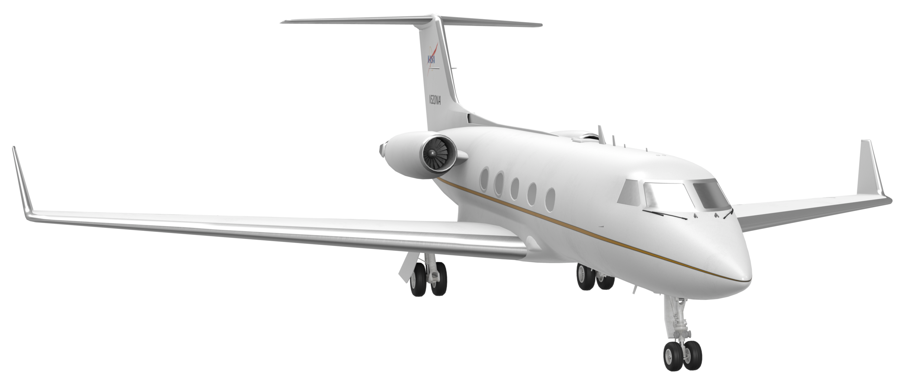
NASA aircraft participating in ASIA-AQ
DC-8: In situ sampling of air quality for gases and aerosols
Instruments: 20+ instruments measuring detailed atmospheric composition
NASA GV: Remote sensing of Air Quality Emissions and Impacts of PM_{2.5} and Ozone
Instruments: UV Spectrometer and Aerosol/Ozone Lidar
NASA GIII: Remote sensing of Greenhouse Gas Emissions
Instruments: Visible/Infrared Spectrometer and Aerosol/Methane Lidar

Slide 5
ASIA-AQ DC-8 Instrument Payload and Investigators
Instrument Name/Technique | Parameters Measured | Investigator(s)
Chemiluminescence | in situ O₃, NO, NO₂ | Ale Franchin and Frank Flocke (National Center for Atmospheric Research)
IR Absorption Spectrometry (DACOM) | in situ CO, CH₄, CO₂, N₂O | Glenn Diskin and Joshua Digangi (NASA Langley)
Diode Laser Hygrometer (DLH) | in situ water vapor | Glenn Diskin (NASA Langley)
Laser Induced Fluorescence | in situ CH₂O | Glenn Wolfe and Tom Hanisco (NASA Goddard)
Tunable Infrared Laser Differential Absorption Spectroscopy (TILDAS) | in situ CH₂O | Joon-Young Ahn (National Institute of Environmental Research
Chemical Ionization Mass Spectrometer (GT-CIMS) | in situ PANs, ClNO₂, Cl₂ | Greg Huey (Georgia Institute of Technology)
Chemical Ionization Mass Spectrometer (K-CIMS) | in situ SO₂, HONO, HO₂NO₂ | Saewung Kim (University of California, Irvine)
Chemical Ionization Mass Spectrometer (CIT-CIMS) | in situ HNO₃, H₂O₂, organic peroxides, organic acids, etc. | Paul Wennberg and John Crounse (California Institute of Technology)
Open-Path Ammonia Laser Spectrometer (OPALS) | in situ NH₃ | Mark Zondlo (Princeton University)
Fast Ethane Spectrometer | in situ C₂H₆ | Dana Caulton (University of Wyoming)
Whole Air Sampler | in situ C₂-C₁₁ alkanes, C₂-C₁₀ alkenes, C₆-C₉ aromatics, C₁-C₅ alkylnitrates, etc. | Donald Blake (University of California, Irvine)
Trace Organic Gas Analyzer (TOGA) | in situ C₃-C₁₀ hydrocarbons, C₁-C₇ OVOCs, HCN, CH₃CN, C₁-C₂ halocarbons, etc. | Eric Apel and Rebecca Hornbrook (National Center for Atmospheric Research)
Proton Transfer Reaction-Time of Flight- Mass Spectrometer (K-PTR-ToF-MS) | in situ speciated nonmethane hydrocarbons and OVOCs | Jeong-Hoo Park (National Institute of Environmental Research)
Proton Transfer Reaction-Time of Flight- Mass Spectrometer (PTR-ToF-MS) | in situ speciated nonmethane hydrocarbons and OVOCs | Armin Wisthaler and Tomas Mikoviny (University of Oslo)

Slide 6
ASIA-AQ DC-8 Instrument Payload and Investigators
Instrument Name/Technique | Parameters Measured | Investigator(s)
Optical particle counters, nephelometers, soot photometer (LARGE) | in situ aerosol number, size distribution, optical and microphysical properties | Luke Ziemba and Richard Moore (NASA Langley)
Single Particle Soot Photometer (K-SP2) | in situ black carbon mass | Sae-Hee Lim (Chungnam National University)
Cloud Condensation Nuclei (K-CCN) counter | in situ CCN number concentration | Seong-Soo Yum (Yonsei University)
High Resolution-Time of Flight-Aerosol Mass Spectrometer (HR-ToF-AMS) | size-resolved submicron aerosol chemical composition | Jose Jimenez and Pedro Campuzano-Jost (University of Colorado)
High Resolution-Time of Flight-Aerosol Mass Spectrometer (K-HR-ToF-AMS) | size-resolved submicron aerosol chemical composition | Taehyoung Lee (Hankuk University of Foreign Studies)
CHemical Analysis of aeRosol ON-line (CHARON) particle inlet coupled to PTR-MS | in situ speciated organic aerosol composition | Armin Wisthaler and Tomas Mikoviny (University of Oslo)
Bulk aerosol filter collection (SAGA) | soluble aerosol composition | Jack Dibb (University of New Hampshire)
Transmission Electron Microscopy (TEM) filter analysis | single particle chemical composition | Kouji Adachi (Meteorological Research Institute, Japan)
Charged-coupled device Actinic Flux Spectroradiometers (CAFS) | upwelling and downwelling actinic flux (4π sr) | Sam Hall and Kirk Ullmann (National Center for Atmospheric Research)
Meteorological Measurement System (MMS) | T, P, horizontal and vertical winds | Paul Bui (NASA Ames)

Slide 7
ASIA-AQ GV Instrument Payload and Investigators
Instrument Name/Technique | Parameters Measured | Investigator(s)
GEO-CAPE Airborne Simulator)/UV Spectrometer (GCAS) | Trace gas column densities of NO₂ and CH­₂O | Laura Judd (NASA Langley) and Scott Janz (NASA Goddard)
High Spectral Resolution Lidar/Differential Absorption Lidar (HSRL/DIAL) | Vertically resolved profiles of aerosol backscatter, aerosol extinction, and ozone | John Hair (NASA Langley)
ASIA-AQ GIII Instrument Payload and Investigators
Instrument Name/Technique | Parameters Measured | Investigator(s)
High Altitude Lidar Observatory (HALO) | Vertically resolved profiles of aerosols; methane column densities | Amin Nehrir (NASA Langley)
Airborne Visible/Infrared Imaging Spectrometer (AVIRIS) | Large point source emissions of CO₂ and CH₄ | Robert Green, Charles Miller, and Michael Eastwood (NASA JPL)
ASIA-AQ (NASA funded) Air Quality Modeling Investigators
Model Name | Investigator(s)
WRF-Chem UCLA | Pablo Saide (UCLA) and David Peterson (NRL)
MUlti-Scale Infrastructure for Chemistry and Aerosols (MUSICA) | Louisa Emmons (National Center for Atmospheric Research)
GEOS-FP and GEOS-CF | Patricia Castellanos and Arlindo DaSilva (NASA Goddard)
UIowa WRF-Chem | Greg Carmichael and Jun Wang (University of Iowa)

Slide 8
DC-8 Team Introduction
AFRC lead for payload integration
Adam Webster is consulting only
Thomas Matthews is primary contact for all payload integration correspondence
Expect email requesting PIFs
Thomas Matthews – Lead Operations Engineer
Nicki Reid – Deputy Lead Operations Engineer
Dan Nolan – Mechanical Design Engineer
Tyler Keppel – Payload Integration / Mechanical Design Engineer
Jeff Nelms – Lab Manager, Laser and RF Safety & Chemical and Gas Safety
John Wong – Pressure Vessel Safety
Jasmine Tabla – Visit Request, Foreign National Escort, Qualified Non-Crew Clearances
Alberto Rodriguez – Logistics
Kirsten Boogaard – Deputy DC-8 Project Manager
Brian Hobbs – DC-8 Project Manager

Slide 9
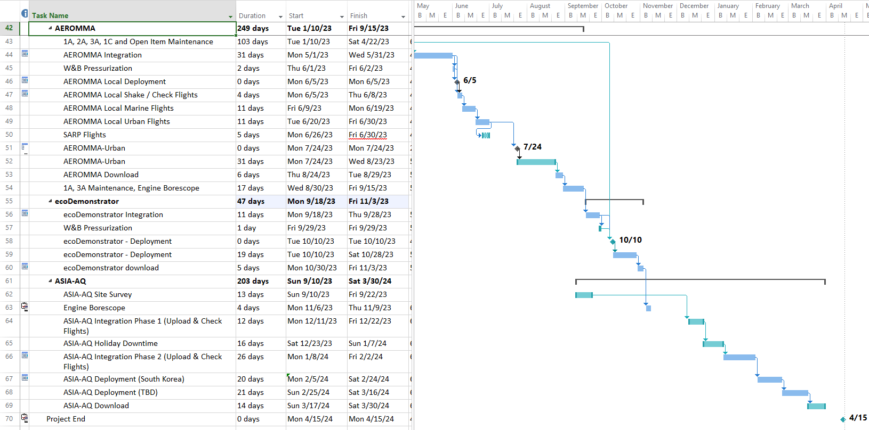
DC-8 Campaign Schedule
DC-8 team will be supporting multiple campaigns during ASIA-AQ planning

