Slide 1
Workstation Admin for International Travel

Slide 2
Windows Workstation Admin
International Travel
Users that go on international travel in certain scenarios may require the users to have elevated privileges to perform functions such as installing software and system configuration changes. Elevated Privileges are not permitted on systems that go on international travel.
WCS in coordination and collaboration with CSET developed and tested new elevated privilege role called “Workstation Admin” for WCS Windows loaner devices. The Workstation admin (WA) role is requested through NAMS, requires PIV re-authentication to elevate admin privilege and is secured through WCS managed group policy.
If users require administrative rights on their workstations, a separate local account on the computer that is a member of the Administrators group (Workstation Admin) shall be used.
  The Workstation admin account allows users that require elevation to present the credentials of that local account for elevation.
  Workstation admin account cannot be used to compromise other computers or access domain resources since the account is not domain user.
  Mitigates pass-the-hash and other credential theft attacks
  Denies access to this computer from the network
  Denies log on as a batch job
  Denies log on as a service
  Denies log on through Remote Desktop Services
WA limitations
  Users would not have the ability to permanently modify configurations or remote into other machines.
  Workstation Admin will open individual applications with Admin rights and once closed, local admin rights will no longer be in use
  Users must initiate the elevation to Workstation Admin
  Workstation Admin can only be used on Windows Systems

Slide 3
Mac Workstation Admin
International Travel
WCS has created a workstation admin request process for users utilizing WCS Mac loaner devices which allows the user to elevate privileges for a defined time (5 Minutes). WCS will be working with CSET to validate the process.
Mac users that have approved international travel requests and require to elevate privilege to perform tasks can request the Mac Workstation admin role by submitting a WCS Change Request with an approved Risk Based Decision (RBD) and submitting the Workstation Admin NAMS request.
The Mac Workstation Admin account is configured through a Jamf policy which allows for the local user account to be elevated from standard user permissions to administrator permission for a set period of time before it is automatically reverted to a standard account.
  Elevated Privileges can only be used if the user/asset are included in the user group.
  The group is linked to the Mac local account and the user's smartcard
  Does not allow users to remote login
  Has to be invoked through software center every time the user wants to elevate privileges.
  End user has to login through VPN or be on the NASA network to access software center.
  Software Center authentication is Agency AUID and Launchpad password (only for elevating privileges)
    If users have sent the launchpad password to MARS they will have to retrieve the password.
    When the end-user returns from travel, they are required to send the launchpad password back to MARS
  Workstation admin privileges will be granted for a maximum of 5 minutes.

Slide 4
Windows and Mac Workstation Admin Request Process
Receive NASA Approval for International Travel
Request for Loaner Devices
Submit Change Request (Standard Change sent to Security to validate RBD)
Complete the RBD form and receive Center CISO Signature
Send the Signed RBD form to WCS Security
Submit the Active Directory Workstation Administrator NAMS Request NAMS ID#266798
  Fill out all required fields
  Click Submit Request
Submit the Workstation Admin NAMS Request NAMS ID#264025
  Ensure required Training is Completed
  Fill out required fields
  Click Submit Request
NAMS Approved and sent to ServiceNow workflow for provisioning
  If issues are identified and ESD ticket will be generated for a technician to assist.
Workstation Admin account provisioned by SysCheck
KB0021607 - Enterprise-Managed: Requesting Active Directory Workstation Administrator
Current Process for Mac Users that will require the Workstation Admin role will be that they have to submit a Change Request and have an approved RBD.
Receive NASA Approval for International Travel
Request for loaner Device
Submit WCS Change Request
Complete the RBD form and receive Center CISO Signature
Submit the Workstation Admin NAMS request NAMS ID#264025
Send the Signed RBD Form to WCS Security
Workstation Admin Role CR will be reviewed and approved by SMOWG

Slide 5
Windows Workstation Admin Request Process

Slide 6
Mac Workstation Admin Request Process

Slide 7
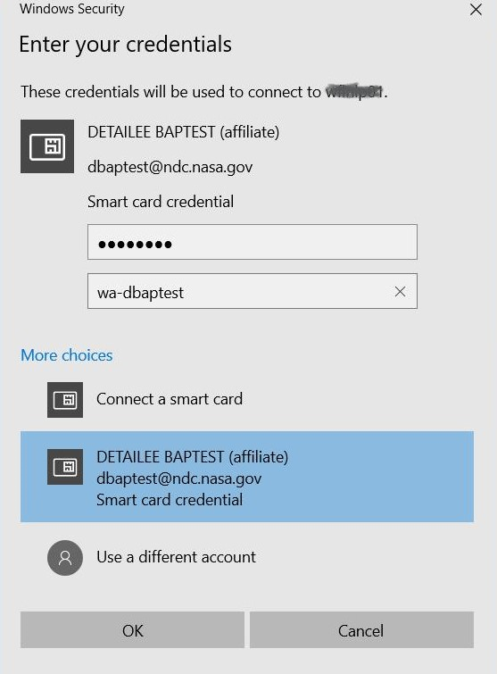
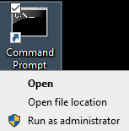
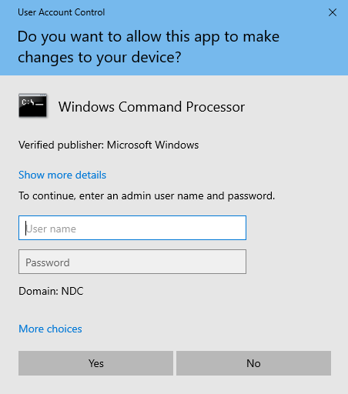
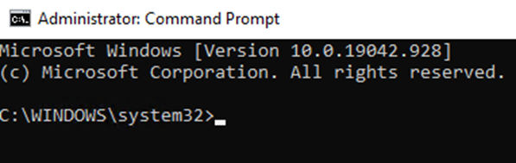
How to use Windows Workstation Admin
How Workstation Admin account is used
Users that have completed the NAMS request and been provisioned the Workstation admin role will elevate privileges when required by following the below process.
Identify the application that needs elevation of privileges
Right-click application “Run as Administrator”
Select More Choices
Select PIV and enter PIN and WA account name
Application will open with Administrator rights
Administrator privileges will be removed after the application is closed

Slide 8
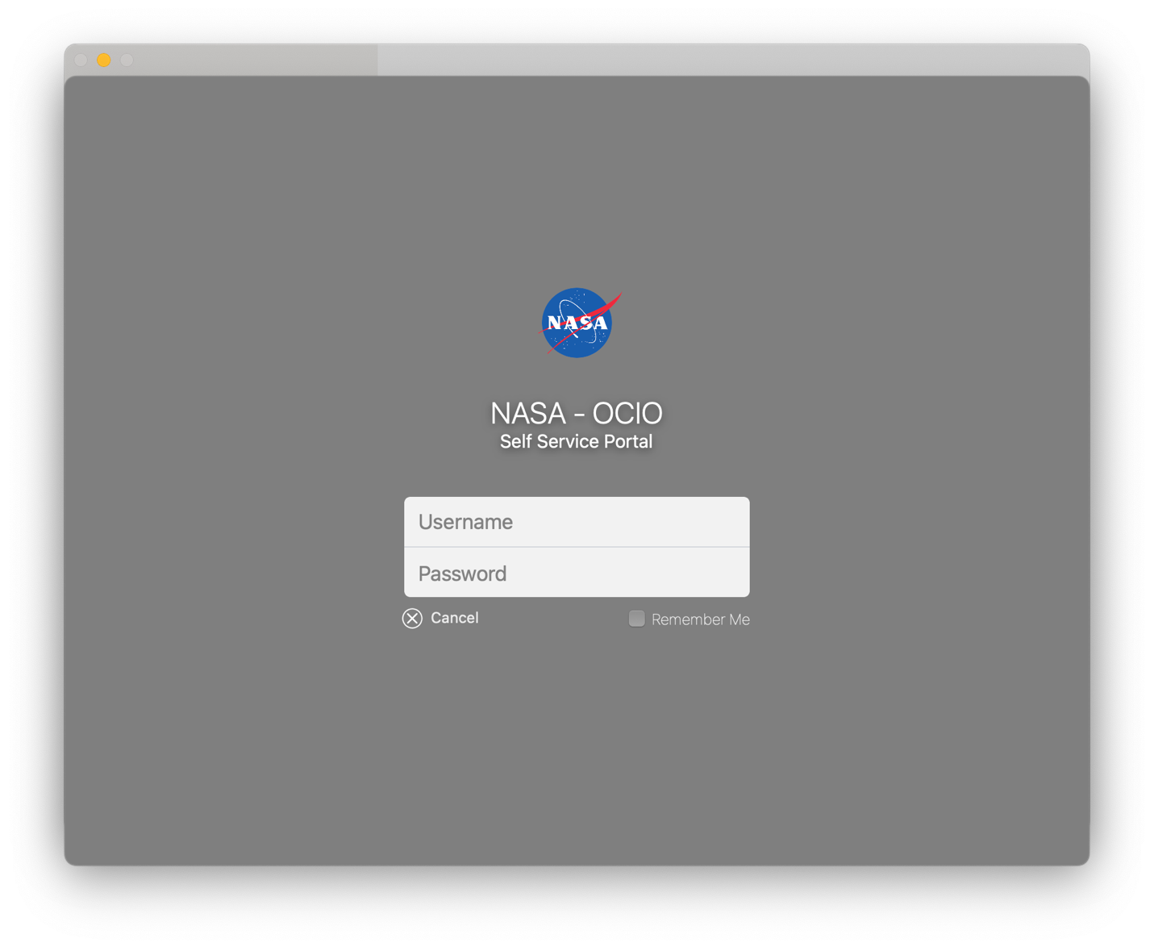
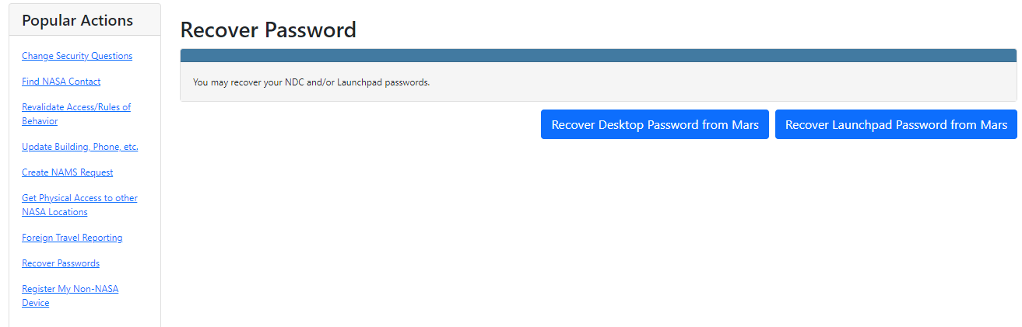
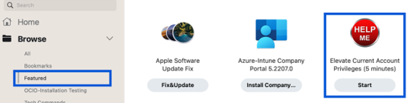
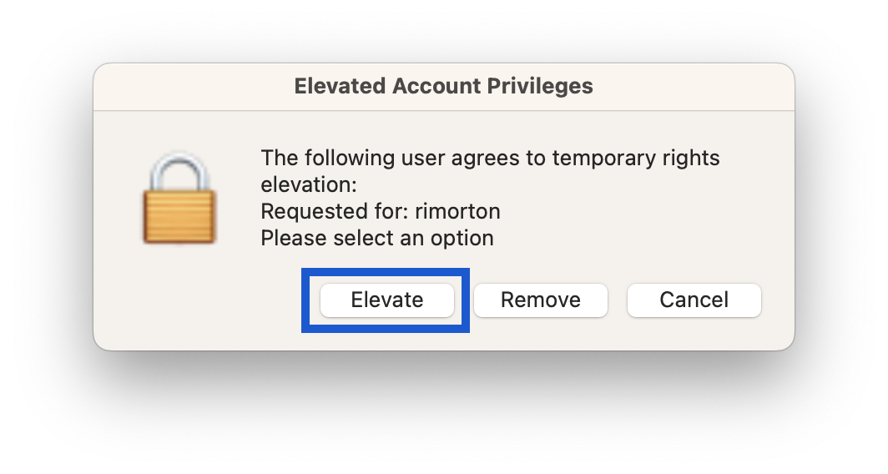
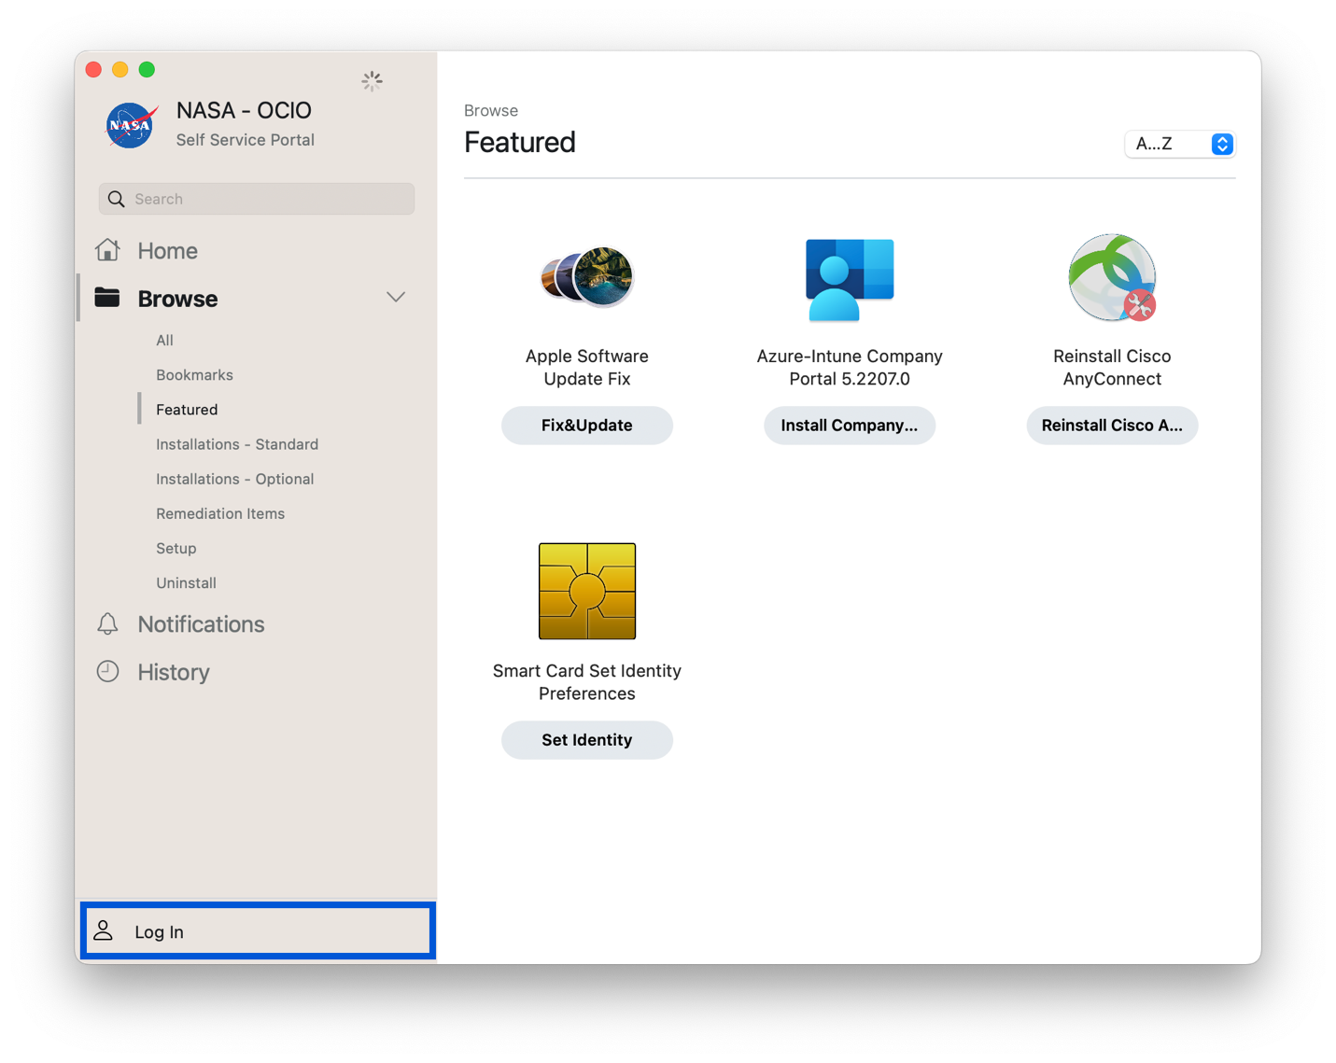
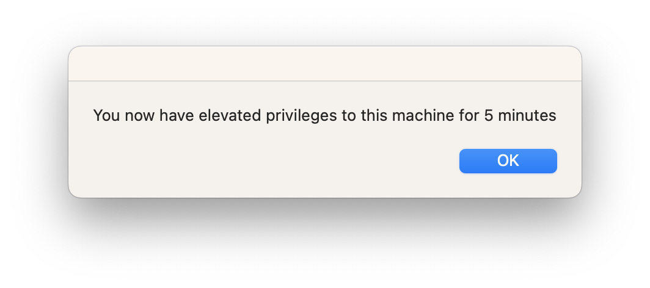
How to use Mac Workstation Admin
How MAC Workstation Admin account is used
Once the Mac Workstation admin role is provisioned the user will have to perform these steps to initiate the elevated privileges for the asset.
Log into the Device with PIV
Connect to VPN or NASA network (Device must be connected to NASA Network)
Open Applications and go to Self Service
If you have sent your password to MARS you will have to retrieve your Launchpad Desktop password from MARS
  Login to id.nasa.gov
  Select Recover Passwords
  Select Recover Launchpad Desktop Password from MARS
Login to Self Service
Enter your Desktop AUID and password
Select Featured and you will see “Elevate Current account privileges (5 minutes)” and click Start
Click Elevate
You will now have Elevated account privileges for 5 Minutes
****Note you can repeat the above steps and remove your admin rights when you are finished by clicking Remove. They will automatically be removed in 5 minutes either way.

Slide 9
Compliance Requirements
Support Executive Order 14028 for improving the Nation’s Cybersecurity, to adhere to the “Zero Trust Architecture” security model which allows users full access but only to the bare minimum they need to perform their job. The security model allows the concept of least-privileged access is applied to every access decision.
  Who, what, where, when, and how to determine the approval and denial of access.
NPR 2810.2 - Possession and Use of NASA Information and Information Systems Outside of the United States and United States Territories
  NASA information, information technology (IT) and information systems, and the accounts that access these systems, must be protected.
  The use of mobile devices to transmit or receive information makes the transmitted information susceptible to eavesdropping, interception, and theft because of transmissions occurring over commercial networks.
  International travel increases these risks, particularly where telecommunication networks are owned or controlled by the host government.
  IT devices are always at risk for the introduction of malicious software and such risks are greater when devices leave the physical control of the traveler.
NASA-STD-2605 – Privileged Access management for computing systems
  Elevated Privileges SHALL NOT be granted for the sole purpose of software installations
  Ensure that the privilege levels no higher than necessary to accomplish required mission and business functions.
NASA-SPEC-2675 Version 1.1 – International Travel
  4.1.6 - All international travel Windows laptops SHALL implement Workstation Administrator (WA) accounts for elevated privileges. WA accounts are granted via NAMS request "Active Directory Workstation Administrator”
NIST 800-53 Rev 5 AC-6 Least Privileges to employ the principle of least privilege and allowing only authorized access for users which are necessary to accomplish tasks in accordance with the mission or business function.

