Slide 1
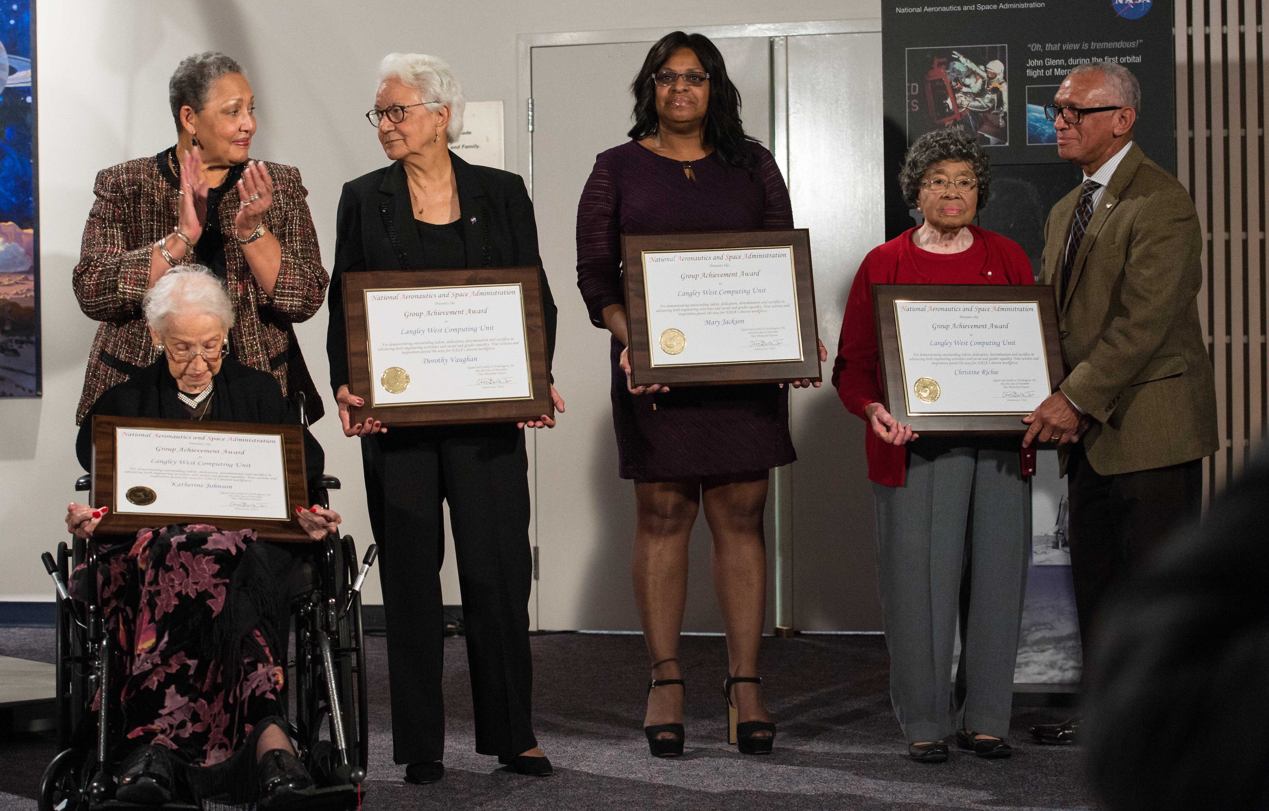
NASA Group Achievement Awards
This prestigious NASA certificate is awarded to any combination of Government and/or non-Government individuals for an outstanding group accomplishment that has contributed substantially to NASA's mission.
All projects prepare GAA’s post deployment
Submittals one a year (this year will be due in July)
GAA’s include project participants, supporting individuals, and all members of ESPO
This prestigious NASA certificate is awarded to any combination of Government and/or non-Government individuals for an outstanding group accomplishment that has contributed substantially to NASA's mission.
Submittals are once a year (the call for the 2023 NASA Honor Awards should open in July this year).
All ESPO projects prepare Group Achievement Awards (GAA’s) post deployment.
GAA’s include project participants, supporting individuals, and all members of ESPO.
Keep awards in mind as you work with people who make substantial impact on your mission and thus, although not on the project participant list, should be included.

Slide 2
Justification, Management approval, Submittal
The Project Manager writes the justification.
Marilyn then reviews it and sends it to management for approval.
Participants are then manually put in the NASA Automated Awards System (NAAS). Get a NAAS account for access. Submittal is tied to the PIV card so same person must put in all names.
To ensure we have all team members, not just those on the participants list. We send emails to all PIs to reconfirm the names of everyone on their team that you have received awards for along with the best mailing address to send the awards to (find best address for PI in ESPO database).

Slide 3
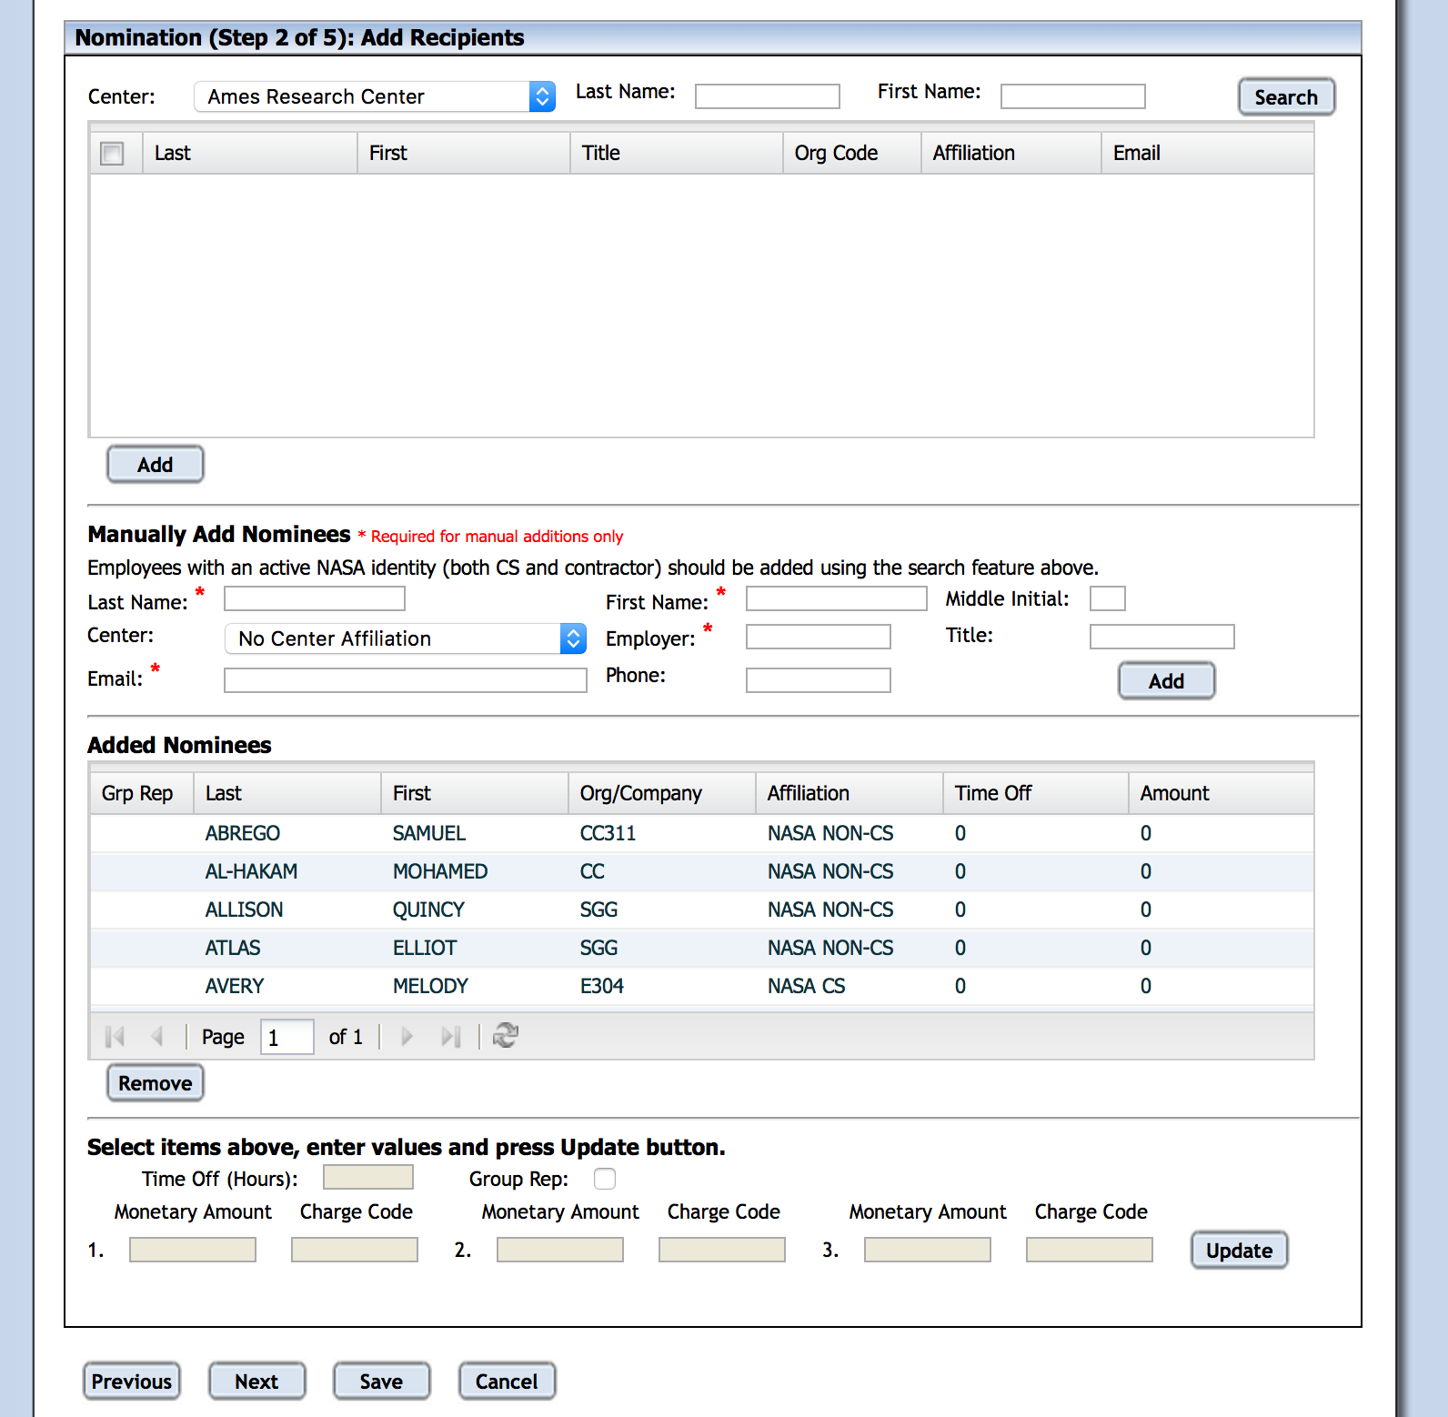
Nomination Revisions
As you receive responses from the PIs, collect any corrections (additional names, change of address, etc.) and gather them to enter into the NAAS system.
There is typically a year between submittal and the awards so keep a master list for when the certificates arrive.
Note: there is usually one run of certificates so try to get it right. There have been cases where they have allowed a second printing.

Slide 4
Shipment Prep and Shipment
Assuming we receive the award. We will be notified and then there will be a ceremony where we receive a plaque and certificates.
Get envelopes from stores stock.
Get congratulatory letter from the ESPO project manager, print many copies and stuff all awards with this letter.
Send an email to each PI to confirm the list and mailing address.
Make labels and send out awards to all teams as the PI responses come in.
ARC shipping will frank and mail the envelopes.

Slide 5
Completion
The justification approval and submittal takes a few weeks but then it is almost a year before the awards are announced and given out.
We try to send out the awards as close as possible to when we receive them because people move/leave.
For more details please reference: https://docs.google.com/document/d/1KRI2FC9mRLSr1e-EAqYscalFV_HlxfDtYTwt0pdpqoA/edit#
This Photo by Unknown Author is licensed under CC BY-SA

