Slide 1
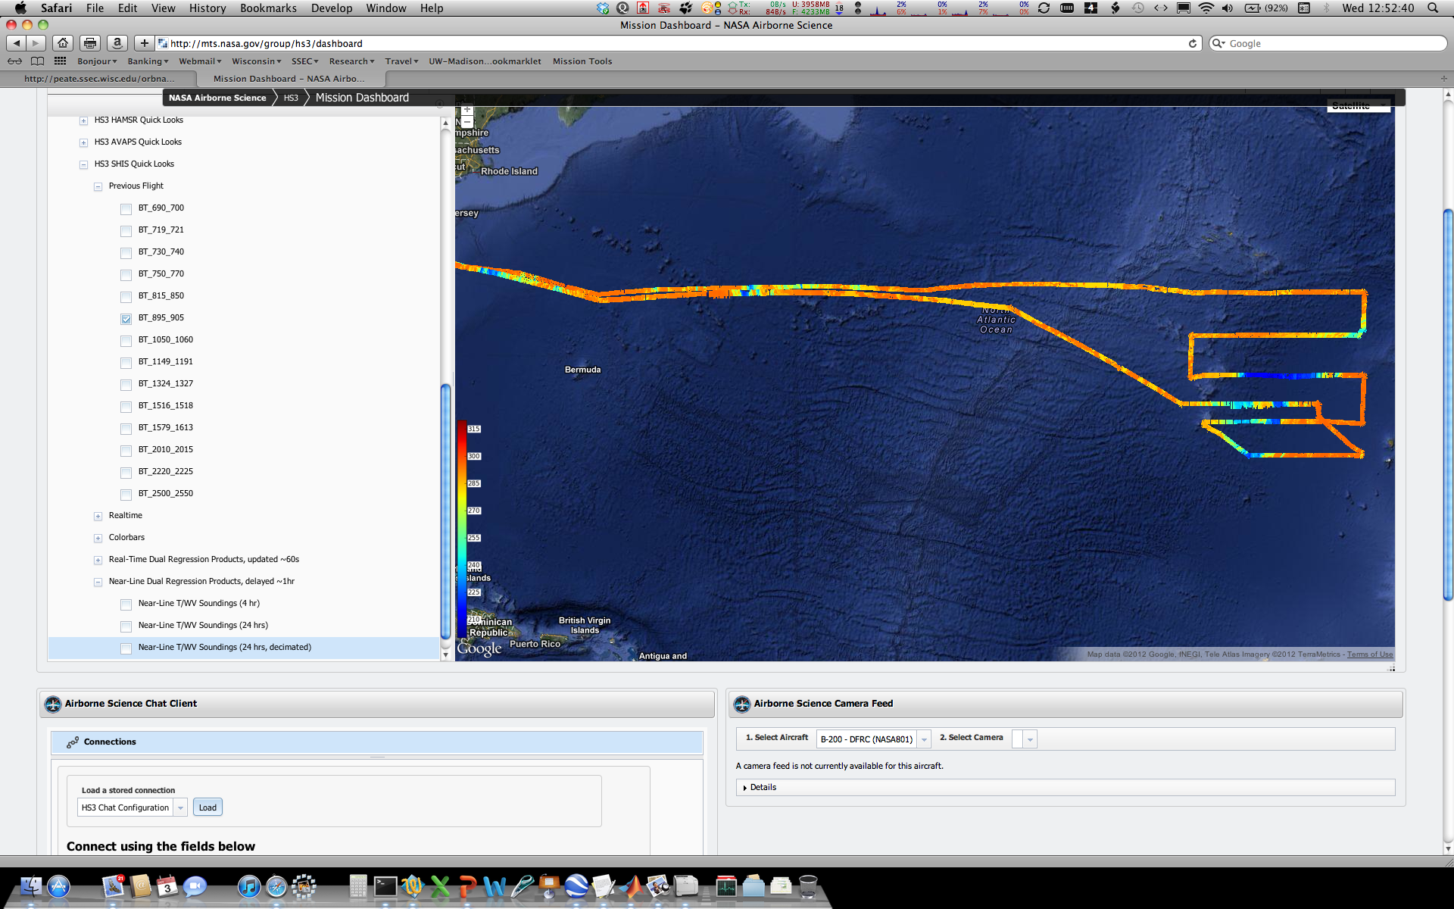
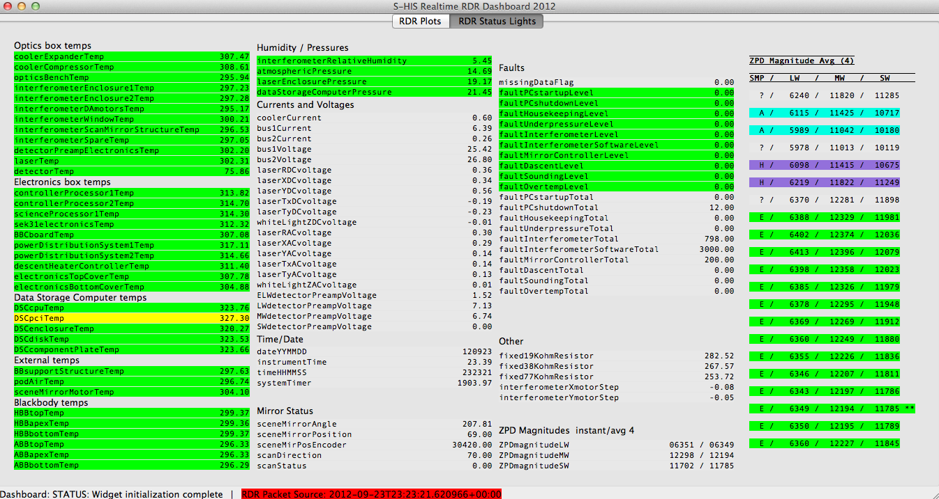
S-HIS: Operated Nominally with NO Downtime
Engineering and Radiance data example
Lessons Learned:
Ground power on aircraft at WFF
With reliable KU, Real-Time dual regression retrievals served in MTS with 40 to 45s second latency

Slide 2
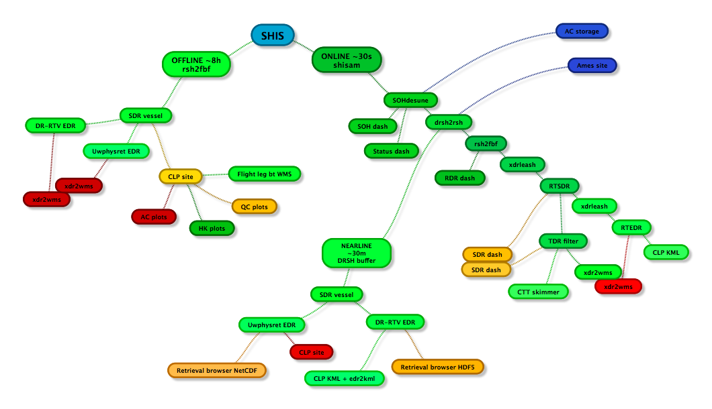
Real-Time Dual Regression (DR) Retrievals
Real-Time DR: 40 to 45s second latency, frequency
DRSH transit time from aircraft to ground, <0.7s
transit time WFF to CA to WI, ~0.2s
RDR to SDR (calibration) processing time, ~0.3s
RT-DR EDR (retrieval) runs every ~35s on latest data, ~35s
KML generation, ~0.2s?
minimum refresh of MTS, 10s

Slide 3
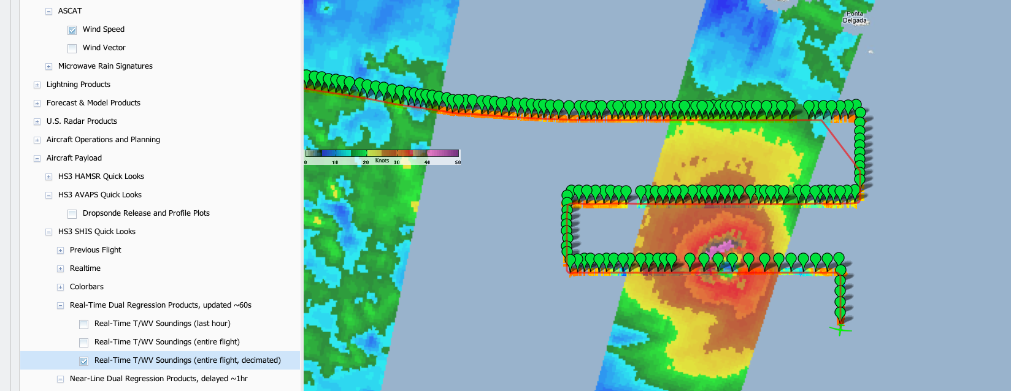
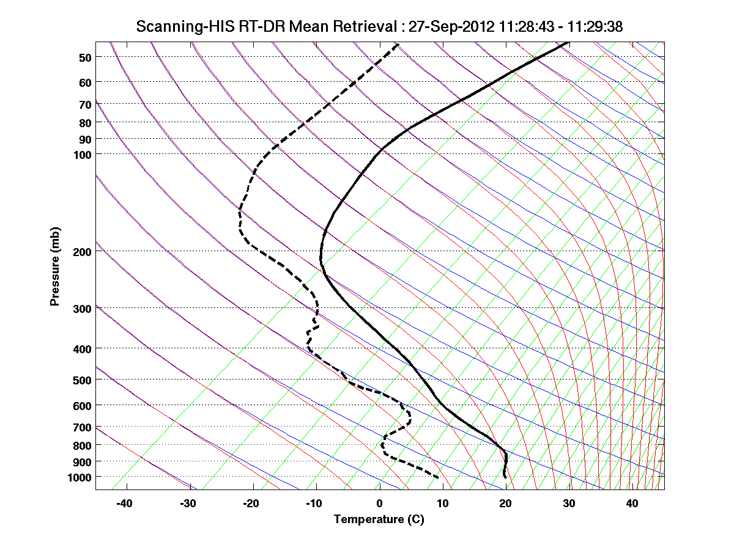
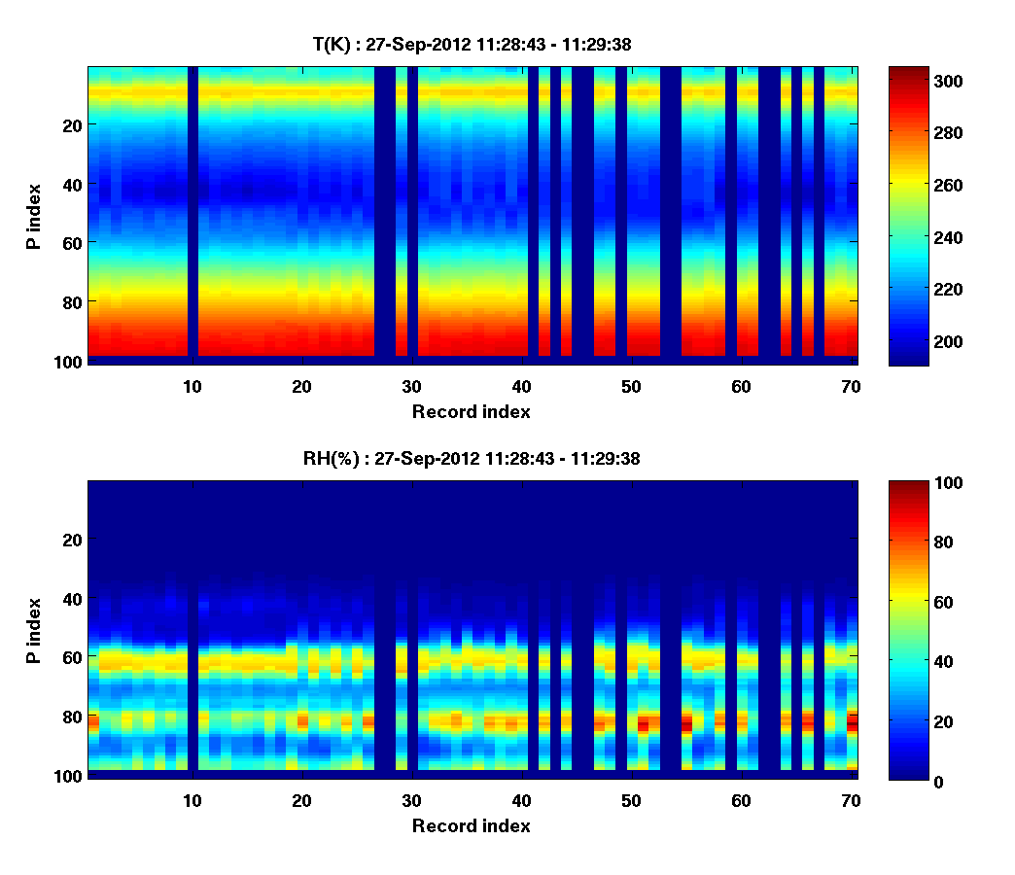
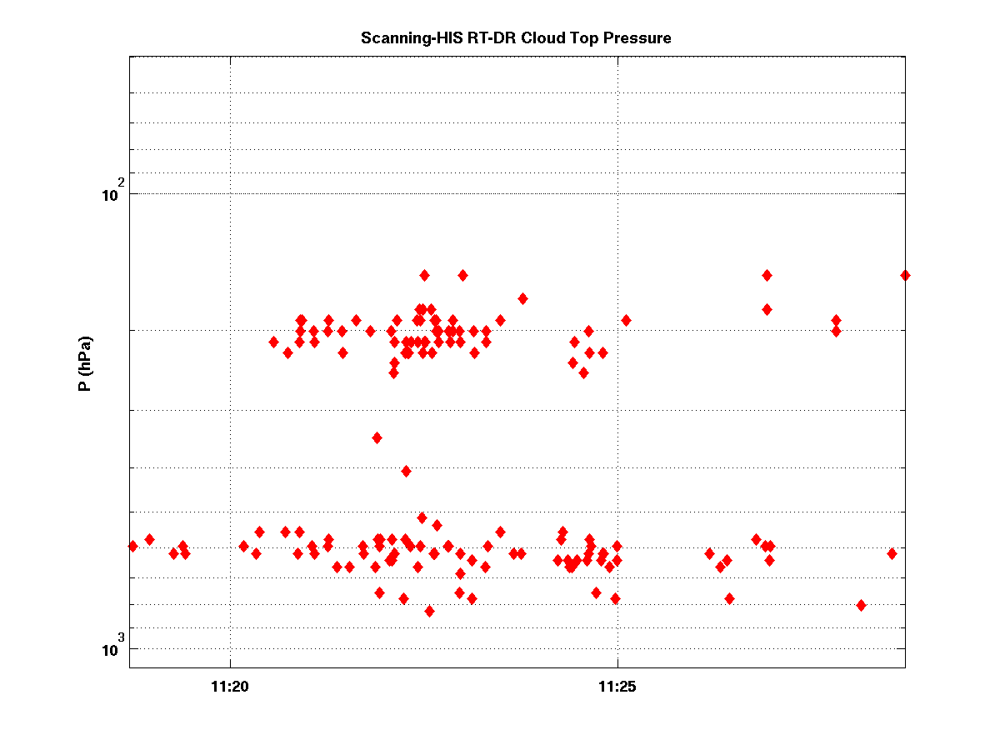
Real-Time Dual Regression (DR) Retrievals
x-sections of individual footprint retrievals
Skew-t of mean retrieval
10 minute history of CTP

Slide 4
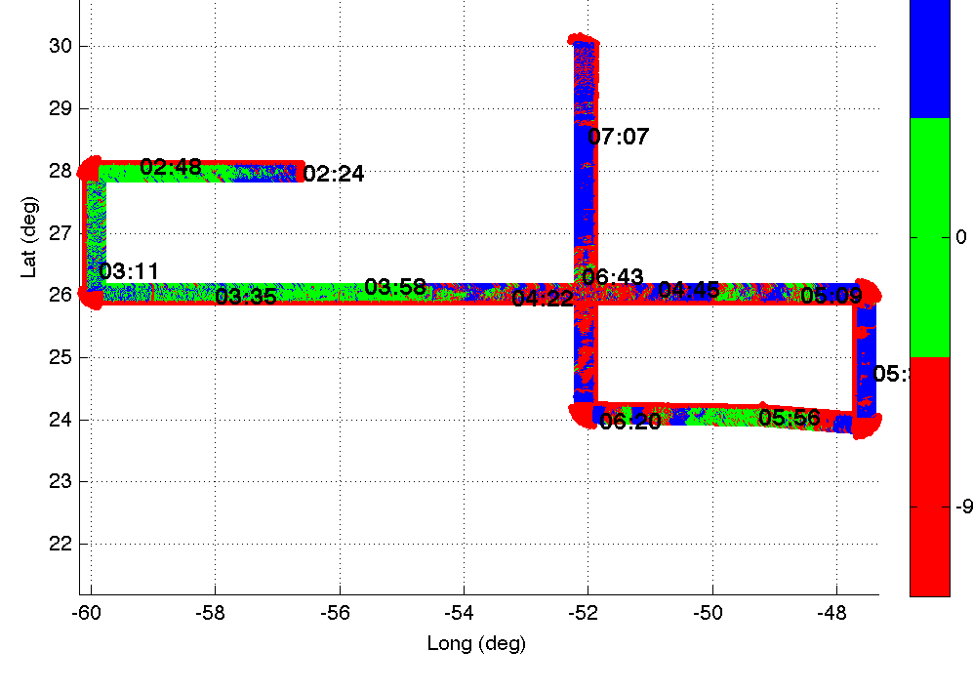
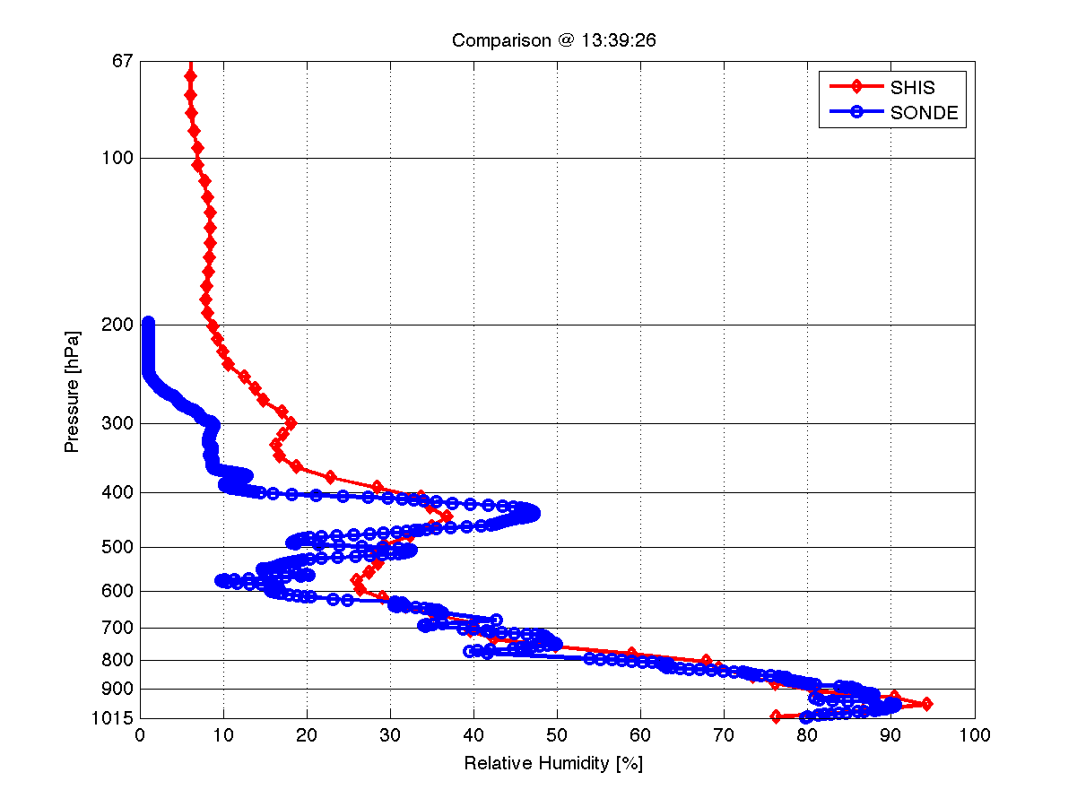
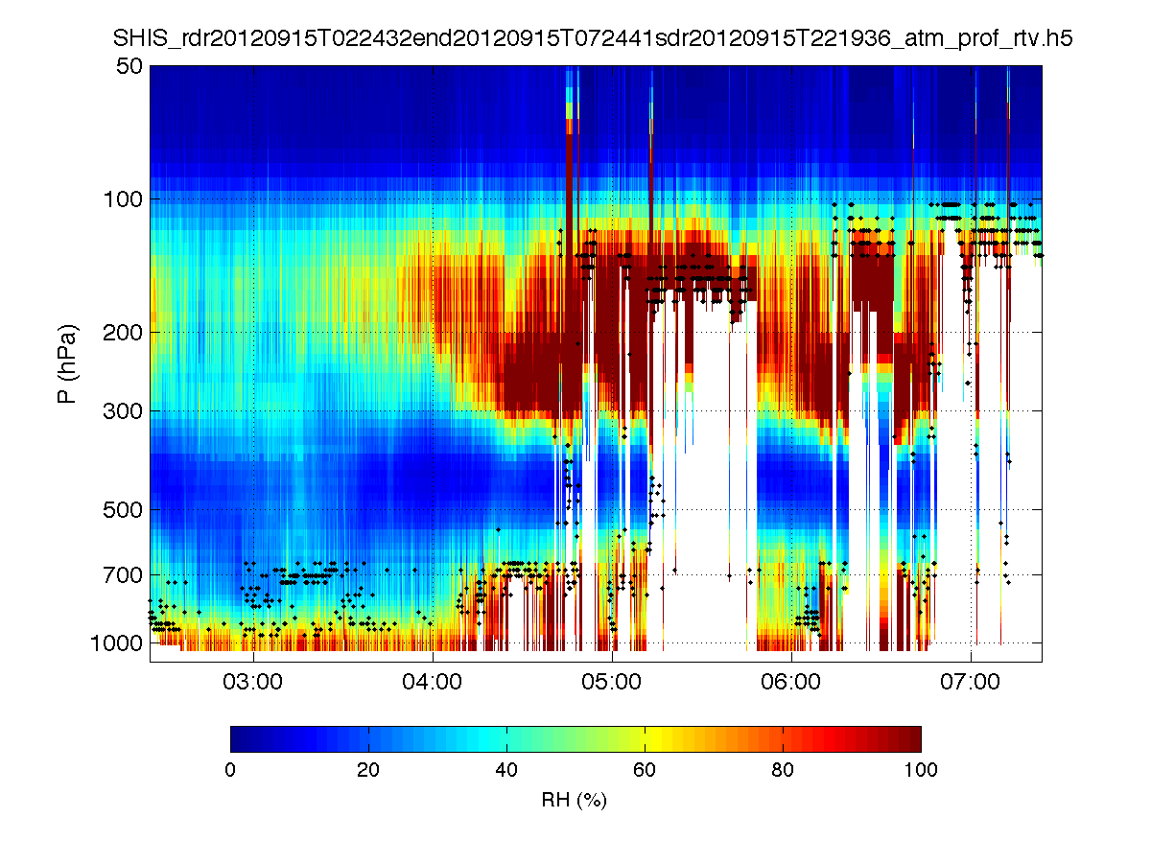
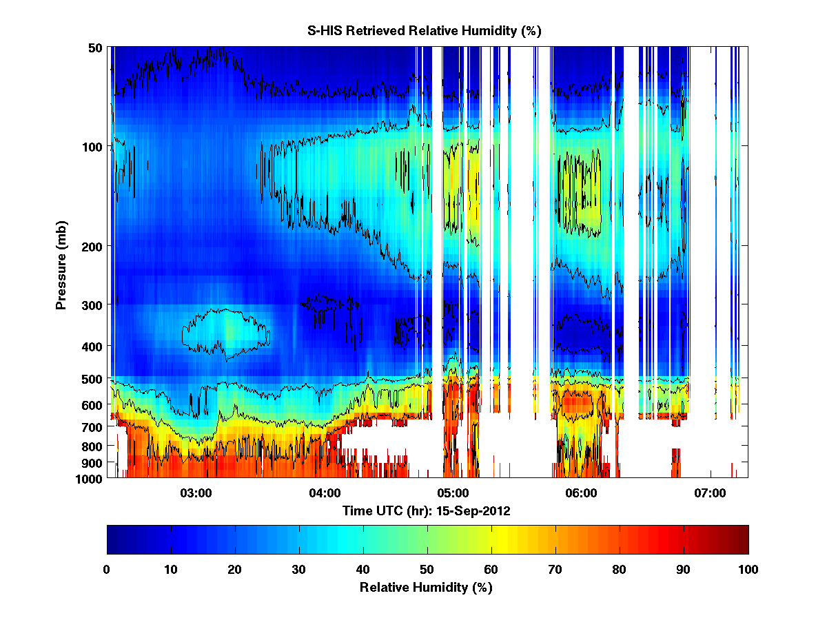
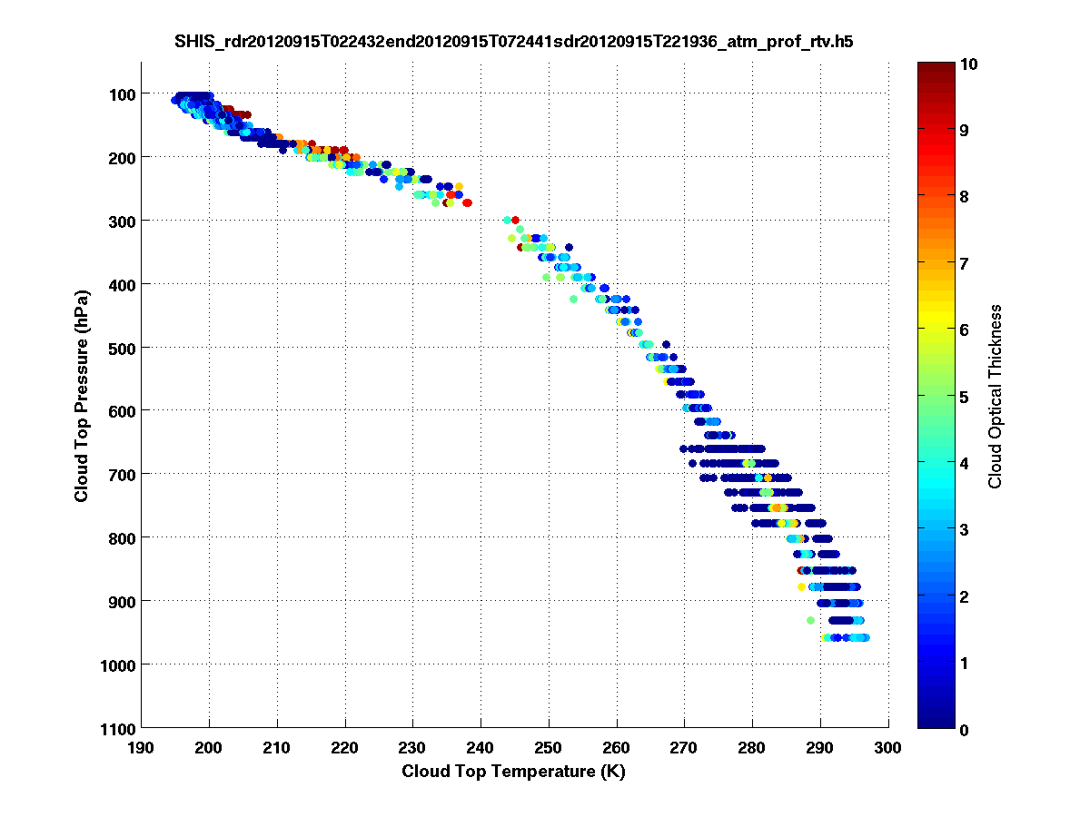
T, RH, and cloud retrieval characterization (work in progress)
15-Sep-2012, S-HIS RH cross-sections
Dual Regression (DR)
07-Sept
Clear Sky Comparison
RH over ice
UWPHYSRET
AVAPS
UWPHYSRET
RH over water
15-Sept
DR CTP versus CTT

