Slide 1
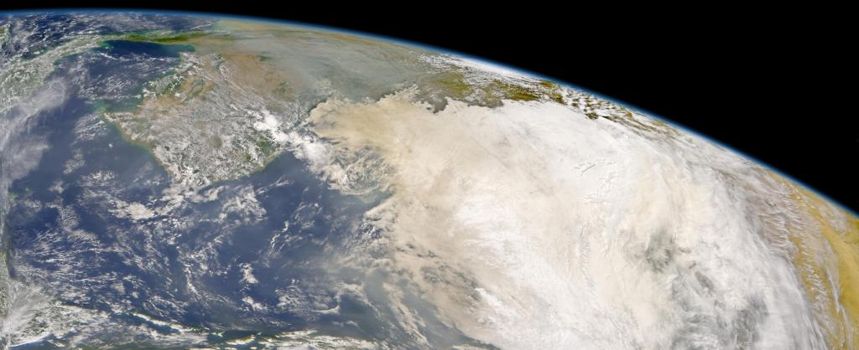
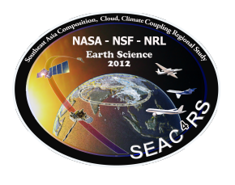
SEAC⁴RS Ground and Ship Measurements Discussion February 2012
NCAR
http://espo.nasa.gov/missions/seac4rs/

Slide 2
Discussion Topics
Site logistics.
There are opportunities of additional instrumentation deployment at the Nepal sites, SE Asia supersites, and the VASCO cruise.
There are a few target regions for ground work, including the Strait of Malacca, the Gulf of Thailand gas platform AERONET site, and he gulf of Tonkin.

Slide 3
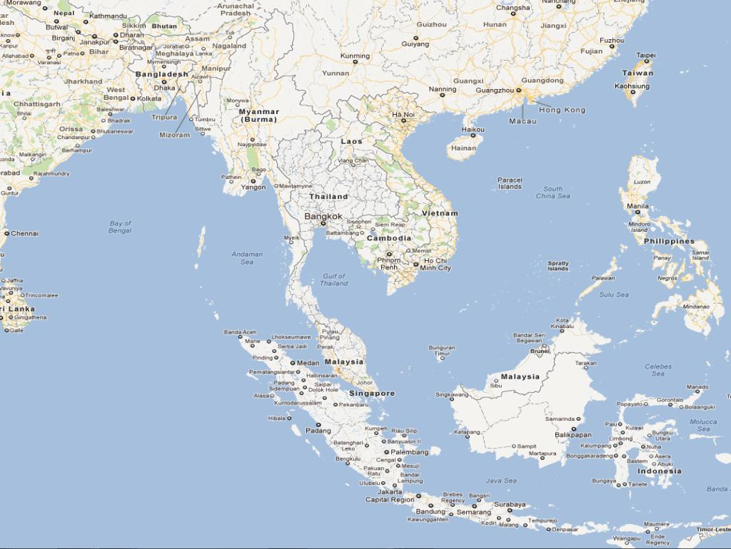
Nepal
Llhasa
Kampur
EPA-NCU
Hong Kong
Hanoi
Spratly Island
over flight opportunity
SEAC⁴RS
Ground Network
VASCO
AERONET+
MPLNet HQ
Bac Lieu
AERONET
Gas platform
Over-flight opportunity
AERONET Intensive
Penang
Radiation Enhanced Site
Pre-ex MPLNET Lidar
Kuching
Non-NASA Lidars
Singapore
Supersite
Intensive ALS Lidar 2 mo
SHADOZ: Daily ozonesonde for45 days
Jambi
VASCO
MAN
Raobs
Jakarta
Other meas. (GAW, SKYNET)

