Slide 1
SEAC⁴RS Data Status, Submitted or Published Manuscripts
Brian Toon
Department of Atmospheric and Oceanic Sciences
Laboratory for Atmospheric and Space Physics
University of Colorado, Boulder

Slide 2
Goal of the meeting
The goal of this meeting is to encourage people to write papers on SEAC4RS data, and to finish the papers they are working on.

Slide 3
Agenda
Tuesday
Biomass combustion
Clouds
Posters
Wednesday
Clouds
UTLS
Breakouts
Thursday
Tropospheric chemistry
Tropospheric aerosols
Posters
Friday
Aerosols

Slide 4
ER-2 data status

Slide 5
Learjet data status
Notes:
What about LWC?, RH, T. PCASP? CCN on wilson

Slide 6
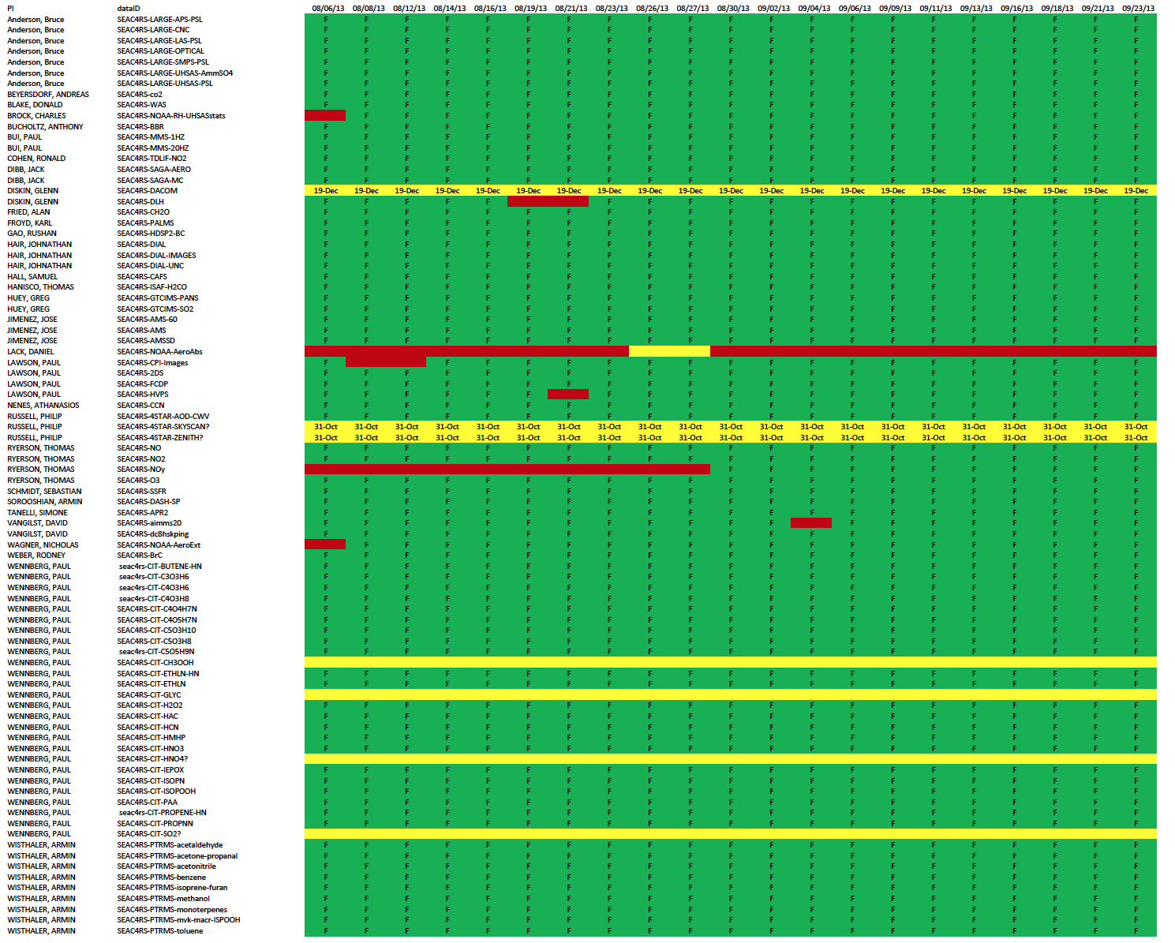
DC-8

Slide 7
Papers we know about

Slide 8
Papers we know about

Slide 9
Papers we know about

