Slide 1
SAL Flight Modules
Scott Braun Jason Dunion
Peter Colarco

Slide 2
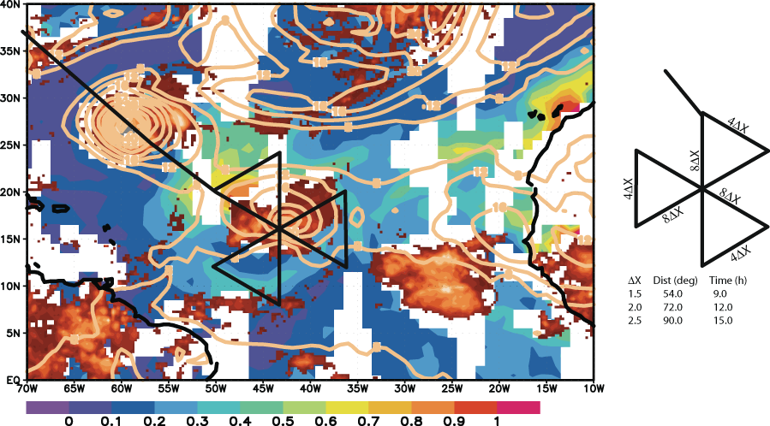
TS or Hurricane SAL Pattern

Slide 3
TS or Hurricane SAL Pattern
Objectives: To measure the structure of the SAL (AEJ structure, warm and dry air, dust) in relationship to a tropical cyclone, with specific focus on the radial structure of the SAL/TC
Conditions for execution: Prominent SAL air mass adjacent to a TC west of 40°W. Particularly interested in cases in which dry air is likely wrapping around southern side of the storm. Pattern must be large enough to extend well past cloudy region into SAL air
For 10° legs, takes about 13 h to complete. Pattern could be asymmetric relative to the center if desired to shorten time.
Dropsondes along all legs every 1°, perhaps 0.5° near dry intrusion.

Slide 4
Advantages/Disadvantages
Advantages
Easy to target convective and/or pouch centers
Good N-S cross section of the AEJ and along the southern SAL edge
Robust sampling of radial gradients around the disturbance
Good for well developed systems and large-scale SAL sampling
Legs good for targeting dry air/aerosol intrusions
Repeated inner-core sampling
Better for rapidly evolving systems

Slide 5
Advantages/Disadvantages
Disadvantages
Azimuthal sampling is limited
Not conducive for regular (grid-like) GPS dropsonde spatial sampling

Slide 6
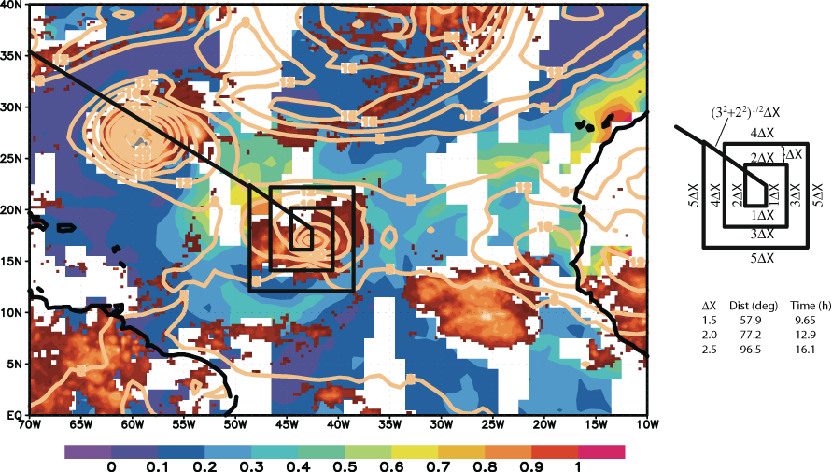
Post-Depression SAL Pattern

Slide 7
Post-Depression SAL Pattern
Objectives: To measure the structure of the SAL (AEJ structure, warm and dry air, dust) in relationship to a tropical cyclone, specifically to look for intrusions of SAL air into the TC inner-core region
Conditions for execution: Prominent SAL air mass adjacent to a TC west of ~40°W. Particularly interested in cases in which dry air is likely wrapping around southern side of the storm. Pattern must be large enough to extend well past cloudy region into SAL air
For 10° outer box, takes about 12.5 h to complete.
Dropsondes on grid along all legs every 1°, perhaps 0.5° near dry intrusion.

Slide 8
Advantages/Disadvantages
Advantages
Easy to target convective and/or pouch centers
Patterns conducive for calculating disturbance centered budgets
Regular (grid-like) GPS dropsonde spatial sampling
Generally good N-S sampling of the AEJ and along the southern SAL edge east and west of center
Better for insipient systems

Slide 9
Advantages/Disadvantages
Disadvantages
Limited sampling of radial gradients around the storm and not close in time
Legs generally not conducive for targeting dry air/aerosol intrusions
Longer on-station times would require more frequent adjustments to flight pattern to account for storm motion
Inner-core region is not sampled more than once
Not optimal for rapidly evolving systems
Less optimal for well developed systems and large-scale SAL sampling

Slide 10
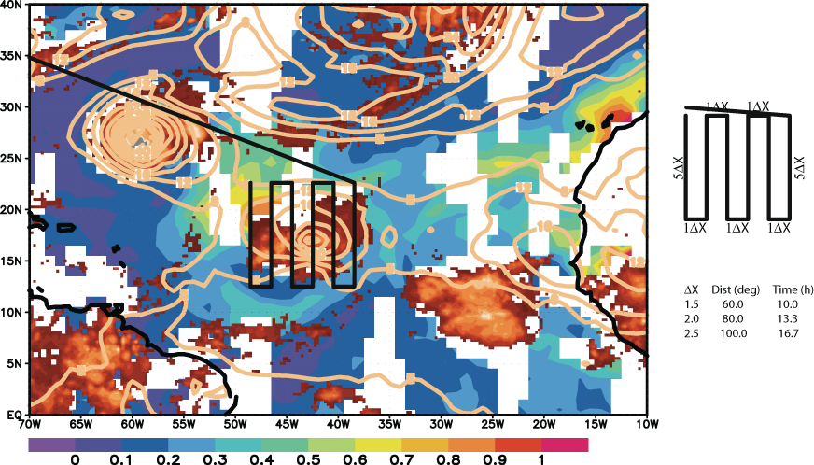
Pre-Depression SAL Pattern

Slide 11
Pre-Depression SAL Pattern
Objectives: To measure the structure of the SAL (AEJ structure, warm and dry air, dust) in relationship to an easterly wave
Conditions for execution: Prominent SAL air mass adjacent to an AEW disturbance centered near ~40°W. Both developers and non-developers desired. Legs must be long enough to extend well past cloudy region into SAL air
For six 10° legs, 2° separation, takes about 12.5 h to complete. Could shorten legs on south side or reduce to 4 legs if desired to go further east.
Dropsondes along north-south legs at least every 1°, perhaps 0.5° near jet axis.

Slide 12
Advantages/Disadvantages
Advantages
Regular (grid-like) GPS dropsonde spatial sampling
Very good N-S sampling of the AEJ and along the southern SAL edge
Better for insipient systems with broad circulations or zonally oriented flows
Good for large-scale SAL sampling

Slide 13
Advantages/Disadvantages
Disadvantages
Not optimal for targeting specific convective or pouch centers
Limited sampling of radial gradients around the storm and not close in time
Legs not generally conducive to targeting dry air/aerosol intrusions
Inner-core region not sampled more than once
Not optimal for rapidly evolving systems
Less optimal for well developed systems

