Slide 1
Testing and improving the parameterization of ice microphysics in CAM5 using MACPEX/SPartICus observations
Hugh Morrison and Andrew Gettelman
NCAR*
Thanks to: Xiaohong Liu, Steve Ghan, Eric Jensen, Paul Lawson, David Mitchell
*National Center for Atmospheric Research is sponsored by the National Science Foundation
MACPEX/SPartICus ST Meeting,
Jan. 18, 2012

Slide 2
Community Atmosphere Model (CAM) Version 5
Dynamics
Surface Fluxes
Radiation
Precipitation
Boundary Layer
Aerosols
-
Mass,
Number Conc
A, q_{c}, q_{i}, q_{v}
re_{i}, re_{l}
Microphysics
Shallow Convection
Clouds (A_{l}),
Condensate (q_{v}, q_{c})
Detrained q_{c},q_{i}
Macrophysics
Deep Convection
Clouds & Condensate:
T, A_{deep}, A_{sh}
A = cloud fraction, q=H₂O, re=effective radius (size), T=temperature
(i)ce, (l)iquid, (v)apor

Slide 3
CAM5 Stratiform Cloud Microphysics (MG)
2-moment microphysics (prognostic number) liquid, ice (Morrison and Gettelman 2008)
Activation from Abdul-Razzak & Ghan (2001) + mods
Explicit considering of cloud water sub-grid variability
Mass & number predicted (gamma function size distributions)
Diagnostic 2-moment rain and snow
Ice nucleation (Liu et al 2007; Gettelman et al. 2010)
Homogeneous freezing on Sulfate
Heterogeneous nucleation on Dust
Ice supersaturation (S_{ice}) and explicit vapor deposition
Consistent treatment of ice in radiation code
Snow and cloud ice both treated in radiation code
Based on SWC/IWC and effective size using Mitchell optics
-

Slide 4
What does stratiform microphysics do in GCMs?
Microphysics controls partitioning and details of condensate:
Particle phase/mean size/number concentration
Critical for determining cloud properties and hence LW and SW radiative forcing, upper-level ice clouds in particular are critical to OLR
Overall precipitation limited by energy balance constraints (P-E), but microphysics can impact distribution

Slide 5
Description on CAM5 ice microphysics
Condensate partitioned into cloud ice and snow, mass mixing ratios and number concentrations predicted for cloud ice and diagnosed for snow
Cloud ice → nucleation, vapor deposition (+ Bergeron), sublimation, sedimentation, melting
Conversion from cloud ice to snow → autoconversion, accretion (aggregation)
Snow → self-collection, sublimation, sedimentation, melting
Particle size distributions represented by exponential functions
Mass-size relations: spheres with bulk density for cloud ice (500 kg m⁻³) and snow (100 kg m⁻³)
Fallspeed-size relations: power law → Ikawa and Saito (1990) for cloud ice, Locatelli and Hobbs (1974) for snow

Slide 6
Results of current CAM5 ice microphysics

Slide 7
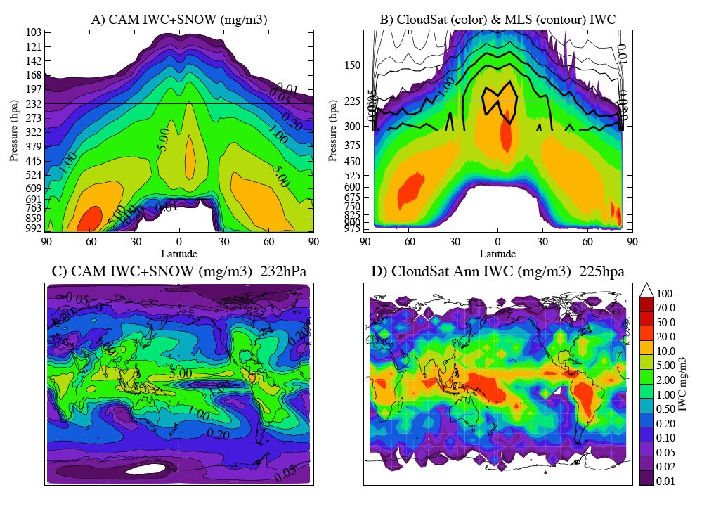
Ice Mass (ICE case) v. Satellite
5.
Gettelman et al 2010, JGR

Slide 8
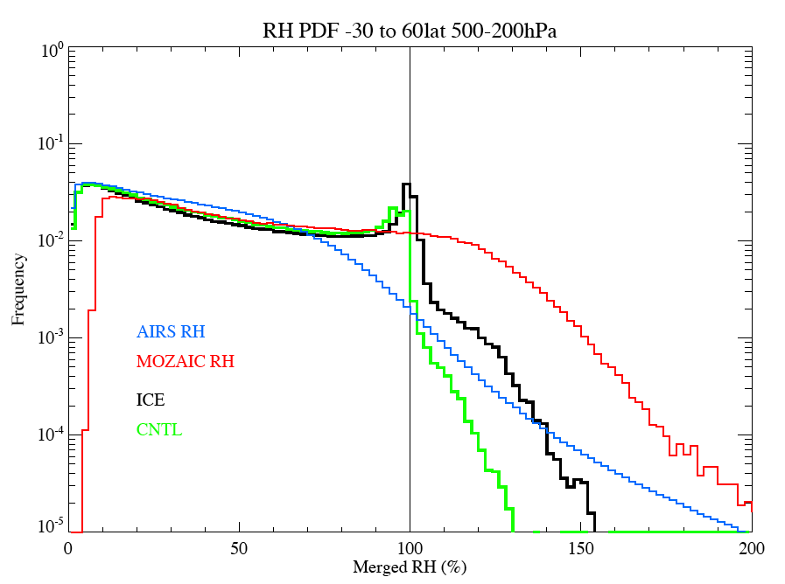
Ice Supersaturation PDF
Sorted by CLDF < 0.7
Cloudy points
Gettelman et al 2006; Gettelman et al 2010, JGR

Slide 9
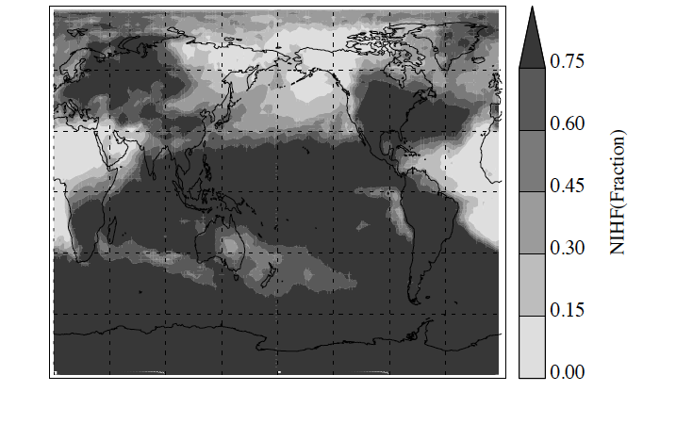
Homogenous Freezing
Homogeneous Freezing contribution to ice crystal number
ICE Homogeneous Freezing Fraction ICE 232hPa Homogeneous Freezing Fraction
Gettelman et al 2010, JGR

Slide 10
Sensitivity Experiments
CNTL: Fixed ice nucleation, limited S_{ice}
FIXIN: Fixed ice nucleation, IN=F(T), with Sice
ICE: CAM5 near final code
ICEHI: Unbounded Homogenous Freezing

Slide 11
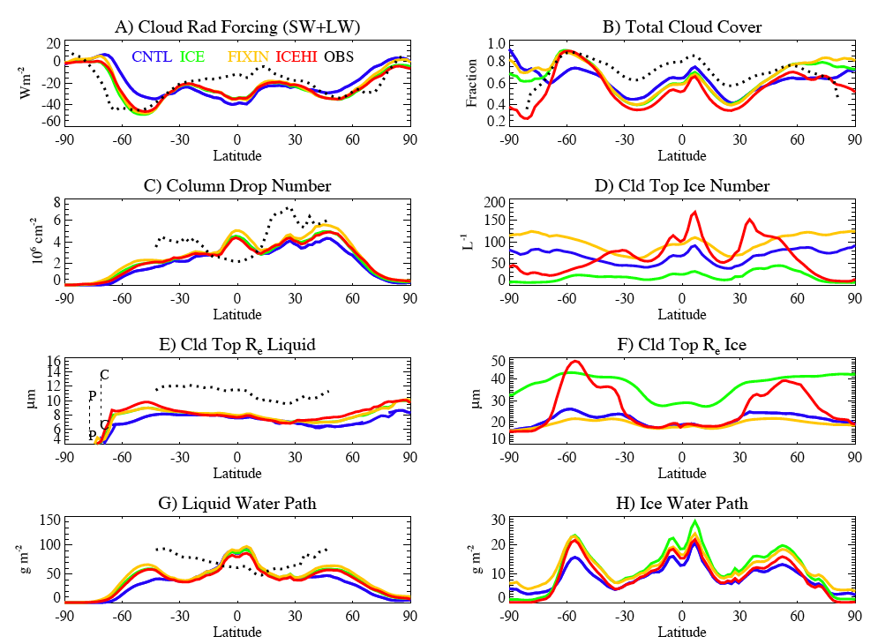
Sensitivity experiments
Gettelman et al 2010, in JGR

Slide 12
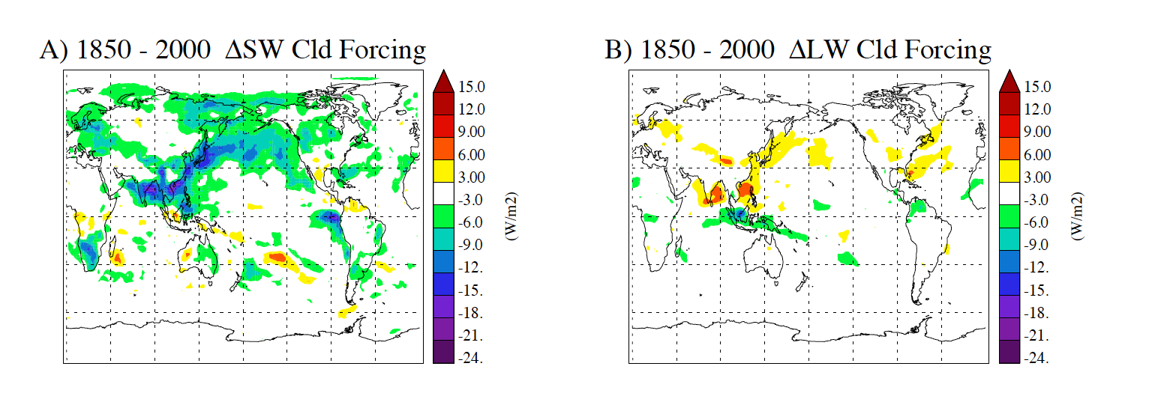
Cloud Forcing: Ice indirect aerosol effects
ΔSW: -1.5Wm⁻² ΔLW: +0.4 Wm⁻²
Ice cloud changes cause increase in LW Cloud Forcing
There is considerable uncertainty in ice indirect aerosol effects!!!

Slide 13
What are the key uncertainties?
Ice nucleation – coupling with aerosols, sub-grid dynamics
Cloud fraction closure, sub-grid variability
Diffusional growth/sublimation
Particle fallspeeds → sedimentation
Particle mass-size relations/densities
Particle size distribution shape (exponential vs. gamma, small vs. large particle concentrations)

Slide 14
Is there “low-hanging fruit” for improving the model?
- Improved self-consistency of various physical processes and
parameters (fallspeed-size, mass-size, optical properties,
PSDs, etc.)
- testing prognostic vs. diagnostic snow, including numerics
- constrain conversion of cloud ice to snow based on ratio of
small and large particle concentrations?
- statistics of sub-grid vertical velocity for ice nucleation?

Slide 15
What in-situ observations are most useful…
- particle size distributions
- bulk IWC, concentration, extinction, etc.
- basic meteorological state (T, RH, etc.)
- mass-size, projected area-size, fallspeed-size size relations
- vertical velocity?

Slide 16
A proposed strategy for testing
Single-column modeling using variational analysis forcing dataset for ARM SPG site
Statistical comparison with observations for runs over the duration of the SPartICus campaign
- focus on relationships between quantities (e.g., IWC or mean
size vs. temperature)
- separation into regimes (e.g., anvil vs. in-situ)
- comparison w/ satellite and ground-based retrievals
Comparison with process modeling (LES) run with similar forcing conditions (e.g., temperature curtain approach)
GCM run in forecast mode (CAPT)?

Slide 17
Global testing for climate runs
Need to be mindful of tuning model to a particular dataset → use all available observations…
- incorporation of other datasets (TC4, MACPEX, etc.)
- use of aggregated datasets from multiple campaigns
Necessity of maintaining realistic cloud radiative forcing, planetary energy balance, etc.

Slide 18
Close coordination with observationalists is critical!

